Slide 1







FUNDERS & PARTNERS
Lighting the Way:
25 Years of Afterschool Excellence
Prime Time Palm Beach County
Afterschool Symposium 2026
SPONSORS
The Elemental Lens: Capturing Confidence through the Voice of C.A.L.M.™
Dr. Deidre Reid-Thomas
Thomas Ed Learning Center
#AfterschoolSYM2026

Slide 2




Introduction
Pediatric ER Doctor or Teacher….
you still Triage and Treat!
  Founder and CEO of Thomas Ed Learning Center/ Creator of Periodic Affirmations™
  20 Years in Public Education
  Classroom Teacher (Math & Chemistry)
  Learning Team Facilitator
  Science and Math Resource Specialist
  10 Years High School Assistant Principal
  Educational Consultant

Slide 3


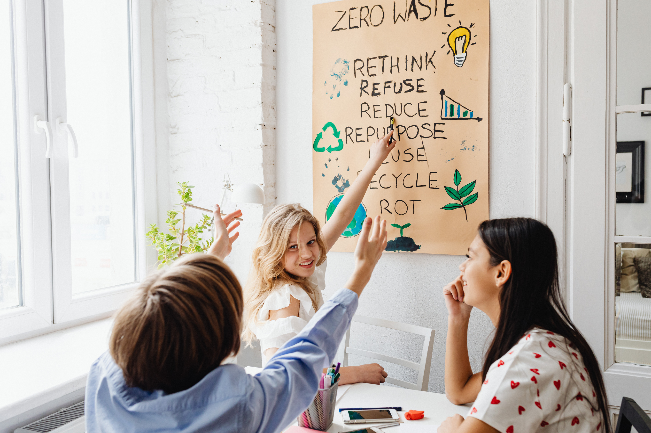

Key Learning Outcomes
By the end of this session, participants will:
Describe how the VOICE of C.A.L.M.™ framework supports whole-child development in OST settings by integrating resilience, academic engagement, and community connection.
Identify practical strategies that help students transition from the school day and regulate emotions for meaningful participation in afterschool programming.
Apply at least one adaptable use of Periodic Affirmations™—such as journaling, discussion prompts, or transition activities—to support focus, self-reflection, and positive engagement.
Reflect on how these tools and strategies can be implemented within their own OST context using existing resources.

Slide 4


It’s Elemental...
Element # 108 Hassium
“I am persistent and resilient, achieving greatness through dedication.”
Scientists had to collide atoms at insanely high speeds, over and over again, just to create a few atoms of Hassium.
And once created? It lasts for only seconds before it’s gone.
But it still earned its spot.
Why? Because of persistence.
Greatness doesn’t always show up loud—it shows up in the dedication to keep going.
Here’s a Journal Prompt for today:
Think about a time when you kept going, even when progress felt invisible.
What kept you moving? What did you learn about your own strength through the process?

Slide 5



Why C.A.L.M. Matters in OST
Students arrive after a full day of structure and expectations
OST time is an opportunity to RESET, REFLECT, and RECONNECT for ALL!
Bridge between academic support and emotional wellbeing = resilience building

Slide 6


Poll #1 & 2:
Where Are Students Struggling the Most?
Notes:
Discuss visible trends and emphasize how C.A.L.M. supports these areas.

Slide 7
Why now is the right time…
Educational Landscape is shifting....
Employment Disparities: Students lacking adequate SEL and academic support are 35% less likely to secure stable employment post-graduation (World Economic Forum, 2020).
A study published in Child Development highlighted that only 29% of students reported feeling socially and emotionally supported in traditional schools, leaving the majority vulnerable to stress and anxiety (Durlak et al., 2011).
Lighting the Way:
25 Years of Afterschool Excellence
Prime Time Palm Beach County
Afterschool Symposium 2026
#AfterschoolSYM2026

Slide 8

Truths
  Holistic education integrates intellectual, emotional, and social development, enhancing academic performance.
  SEL encompasses a broad range of skills, including self-awareness, self-management, social awareness, relationship skills, and responsible decision-making.
  SEL benefits all students.
Notes:
Drop a 1 in the chat if you believe these are skills that every child regardless of behavior should possess?

Slide 9

Truths
  Interactive lessons and collaborative projects can be facilitated using existing resources, making them accessible and cost-effective.
  Innovative strategies are versatile and can be applied across all disciplines.

Slide 10

Truths
  Engaging families and community members in education significantly boosts student achievement.
  Effective school-community partnerships are reciprocal, offering mutual benefits.

Slide 11
You need each of these parts in order to be successful…
Lighting the Way:
25 Years of Afterschool Excellence
Prime Time Palm Beach County
Afterschool Symposium 2026
#AfterschoolSYM2026

Slide 12

Consequences
  Decline in Emotional Regulation and Mental Wellbeing
  Reduced Academic Achievement
Notes:
Studies show that students participating in social-emotional learning (SEL) programs demonstrate an 11% improvement in academic performance compared to peers without SEL support. (Collaborative for Academic, Social, and Emotional Learning, 2021)

Slide 13

Consequences
Limited Student Engagement and Motivation
Inequitable Learning Outcomes
Insufficient Development of 21st-Century Skills

Slide 14

Consequence
  Reduced Opportunities for Real-World Learning
    Internships
    Community Projects
    Experiential Learning Opportunities
Notes:
Students involved in real-world learning experiences are 50% more likely to report feeling prepared for post-secondary education or the workforce. (American Institutes for Research, 2021)
All Theory but no application
At the end of the day we want to equip them with all the skills necessary to be successful no matter where they go...

Slide 15


Slide 16
Time to see things from your
Elemental Lens…
Lighting the Way:
25 Years of Afterschool Excellence
Prime Time Palm Beach County
Afterschool Symposium 2026
#AfterschoolSYM2026

Slide 17



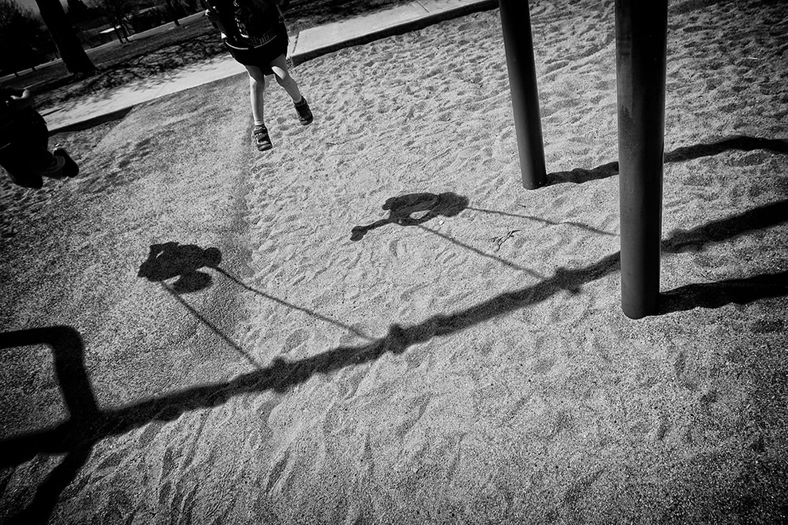
Using Light in Photography
Backlighting: subject between light and camera
Silhouettes: bold shapes with contrast
Shadows: express depth and emotion

Slide 18


Photography Challenge:
Caption Your Shine
Share & Reflect
  Capture 1 photo using light to symbolize your brilliance. Share with your group members and select one to share.
  Think: Who do I inspire? What makes my energy stand out?
    Title it.
    On a sticky note Write a caption using: “I shine by…”
    Upload to Slides with Friends

Slide 19


Slide 20




Building a C.A.L.M. Module Routine
Handout: “Design Your 15-Minute C.A.L.M. Module”
Components:
  Emotional Reset (Affirmation or breathing exercise)
  Academic Focus (Skill practice or creative learning)
  Community Connection (Group reflection or share-out)

Slide 21
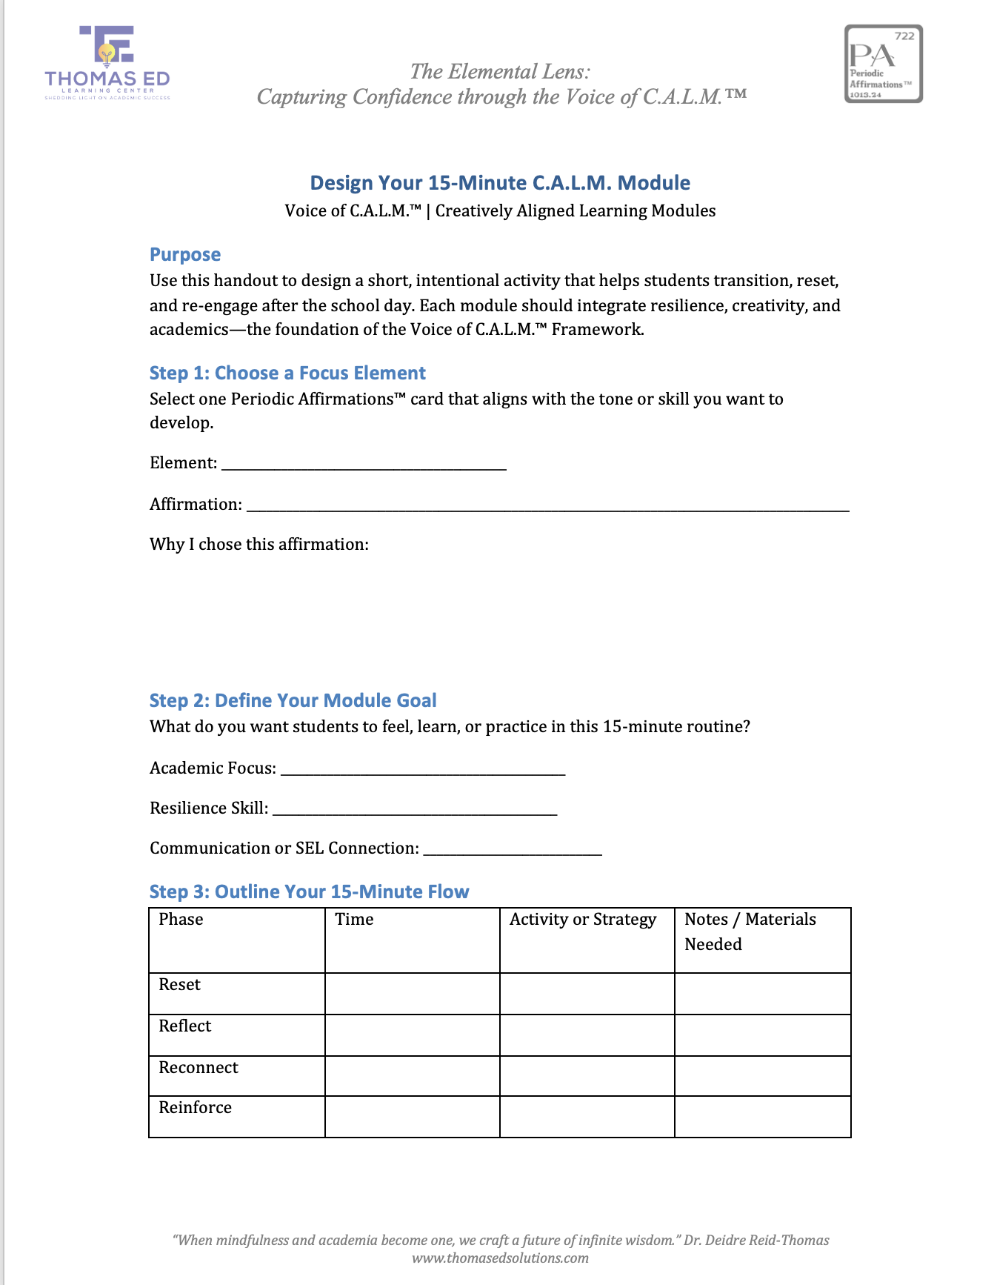
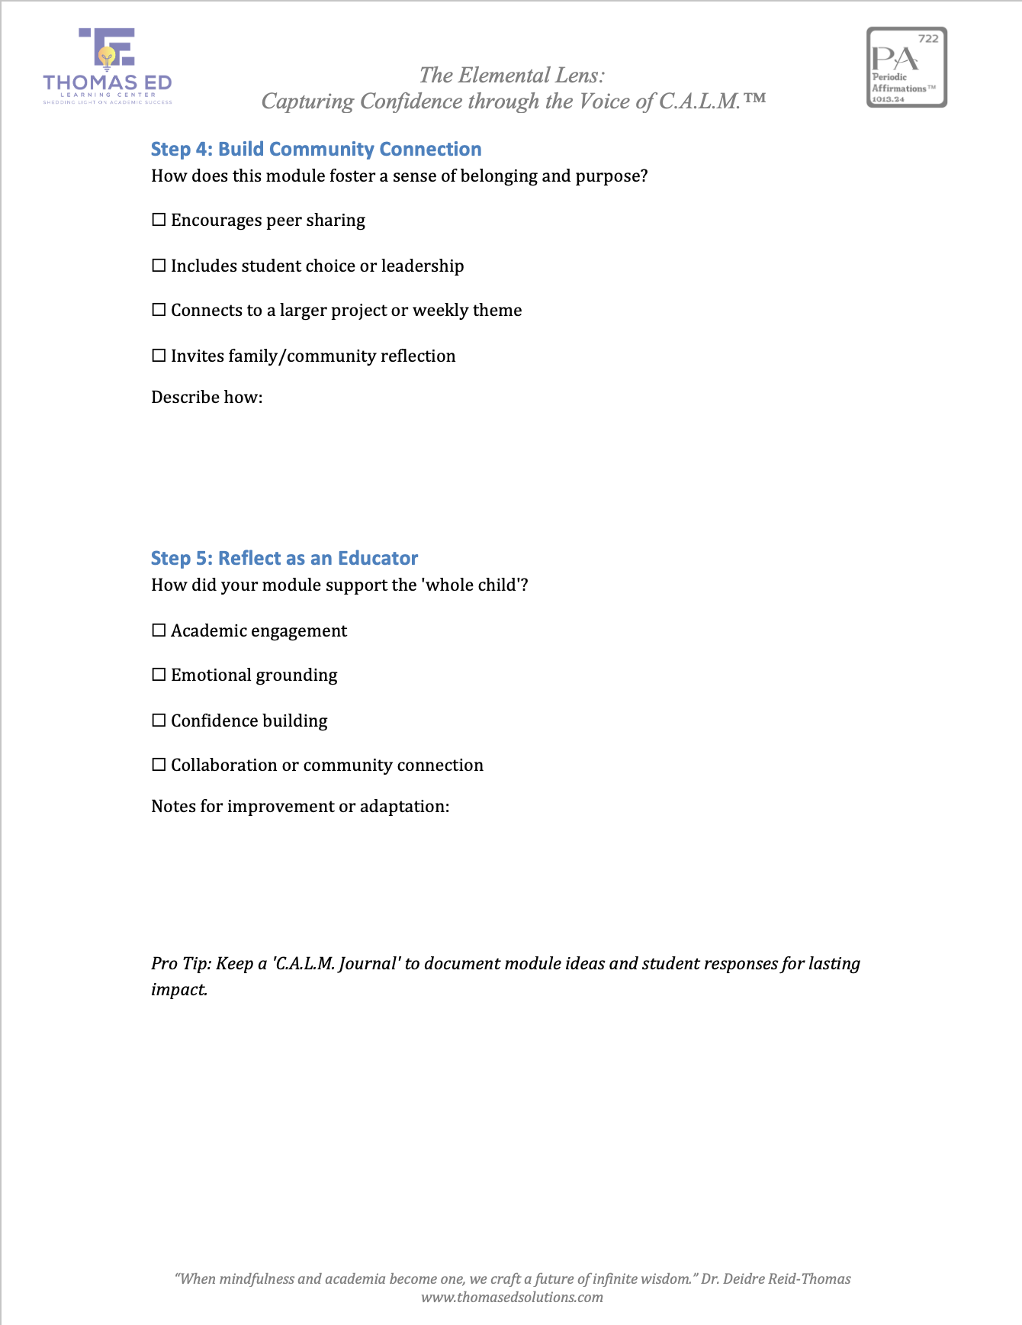

Slide 22
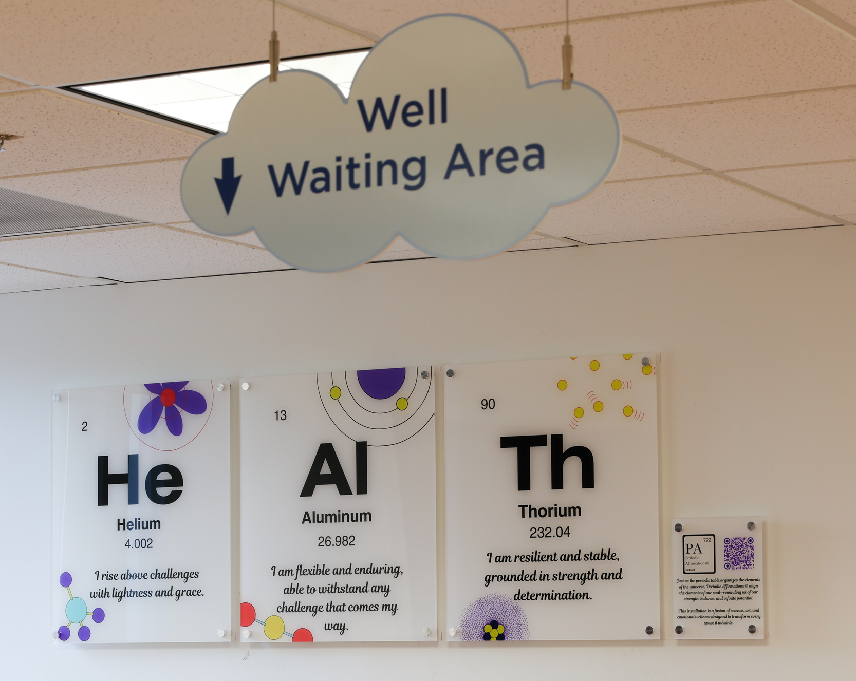
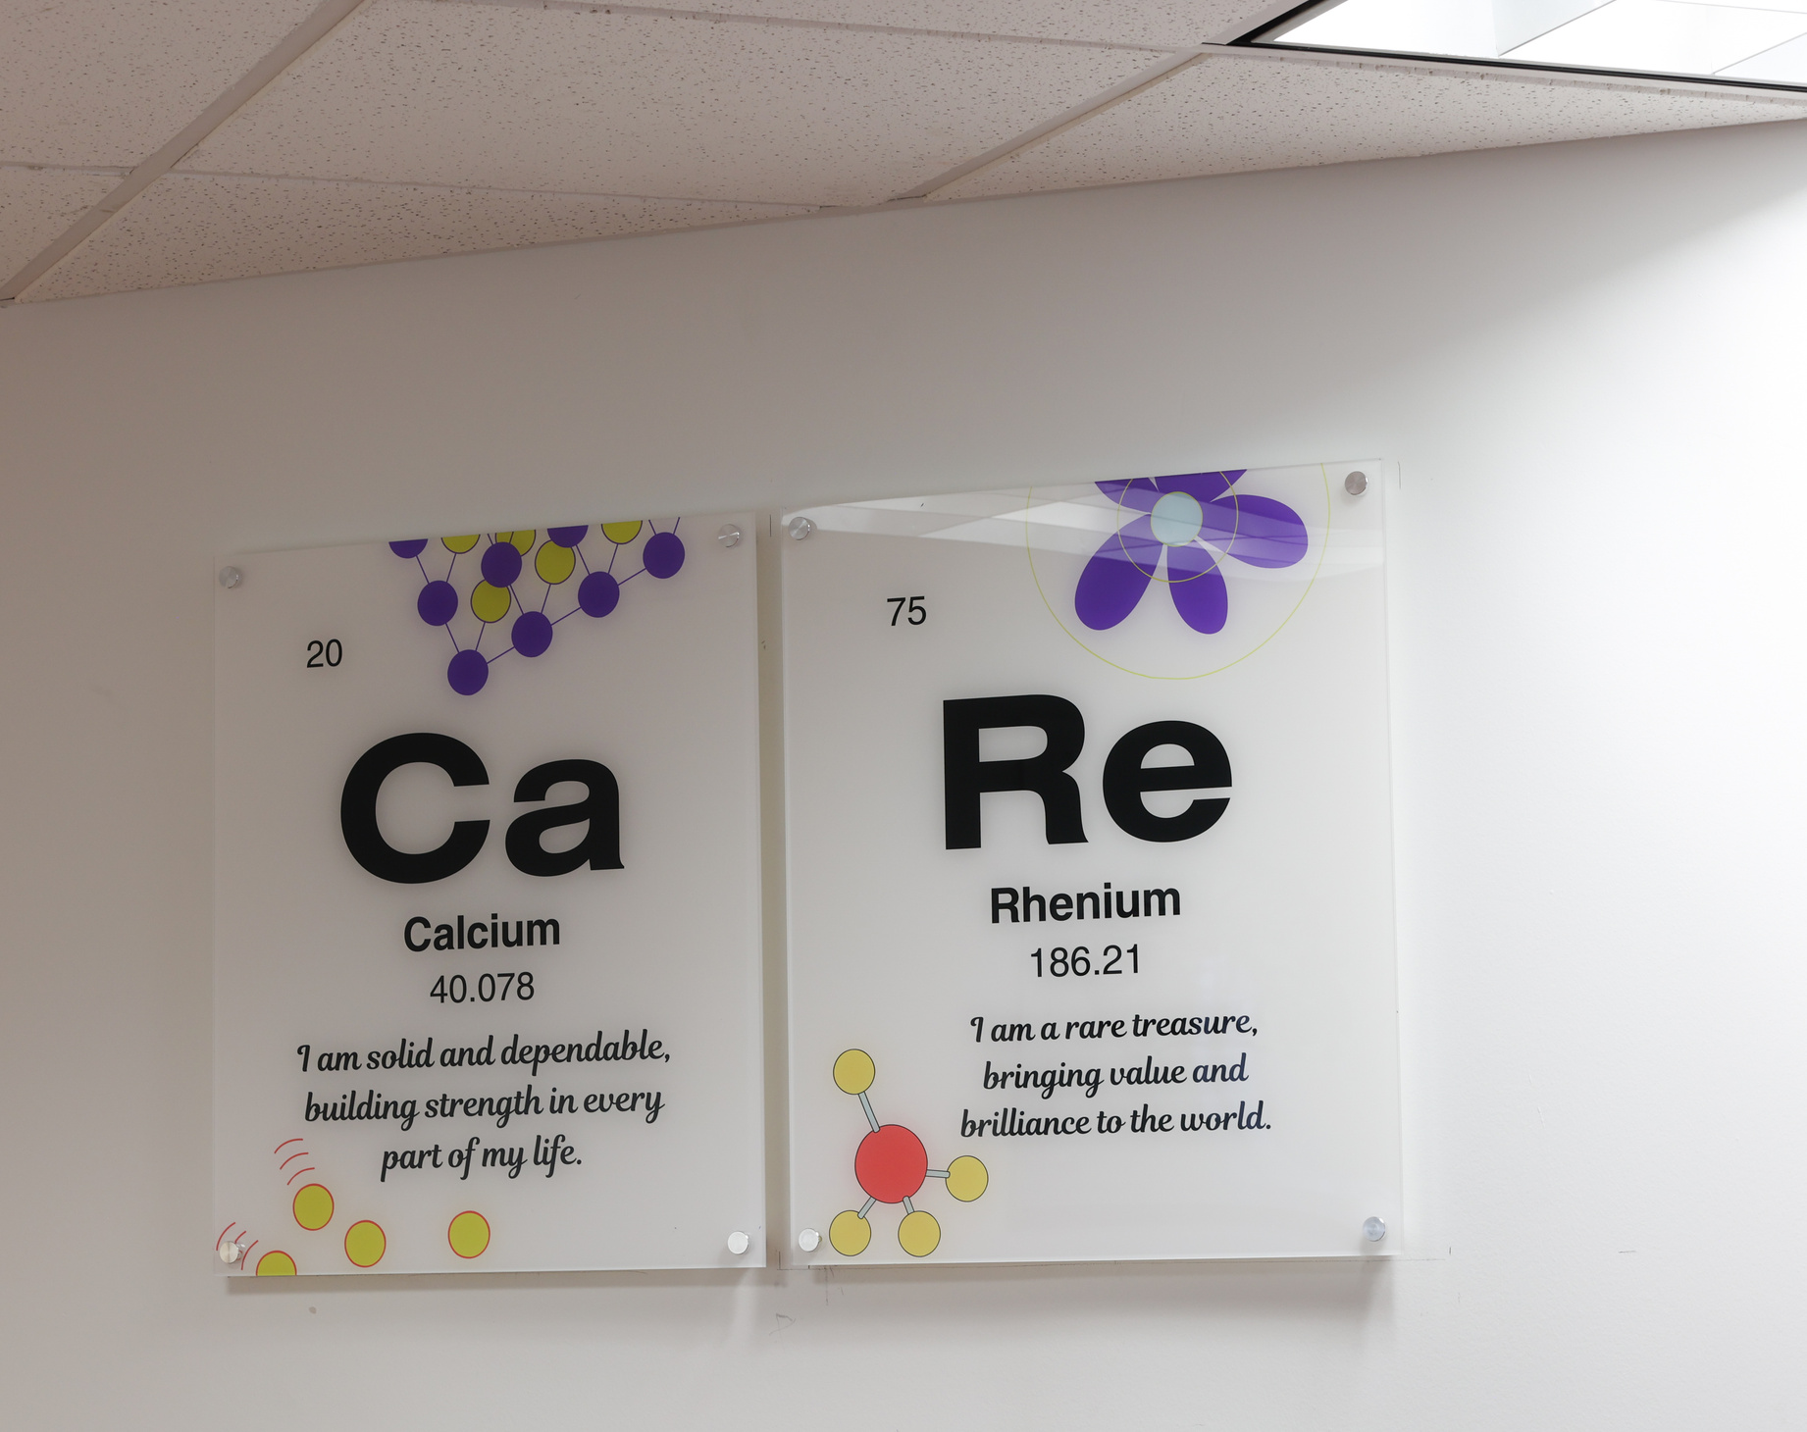
Transforming one space at a time....

Slide 23
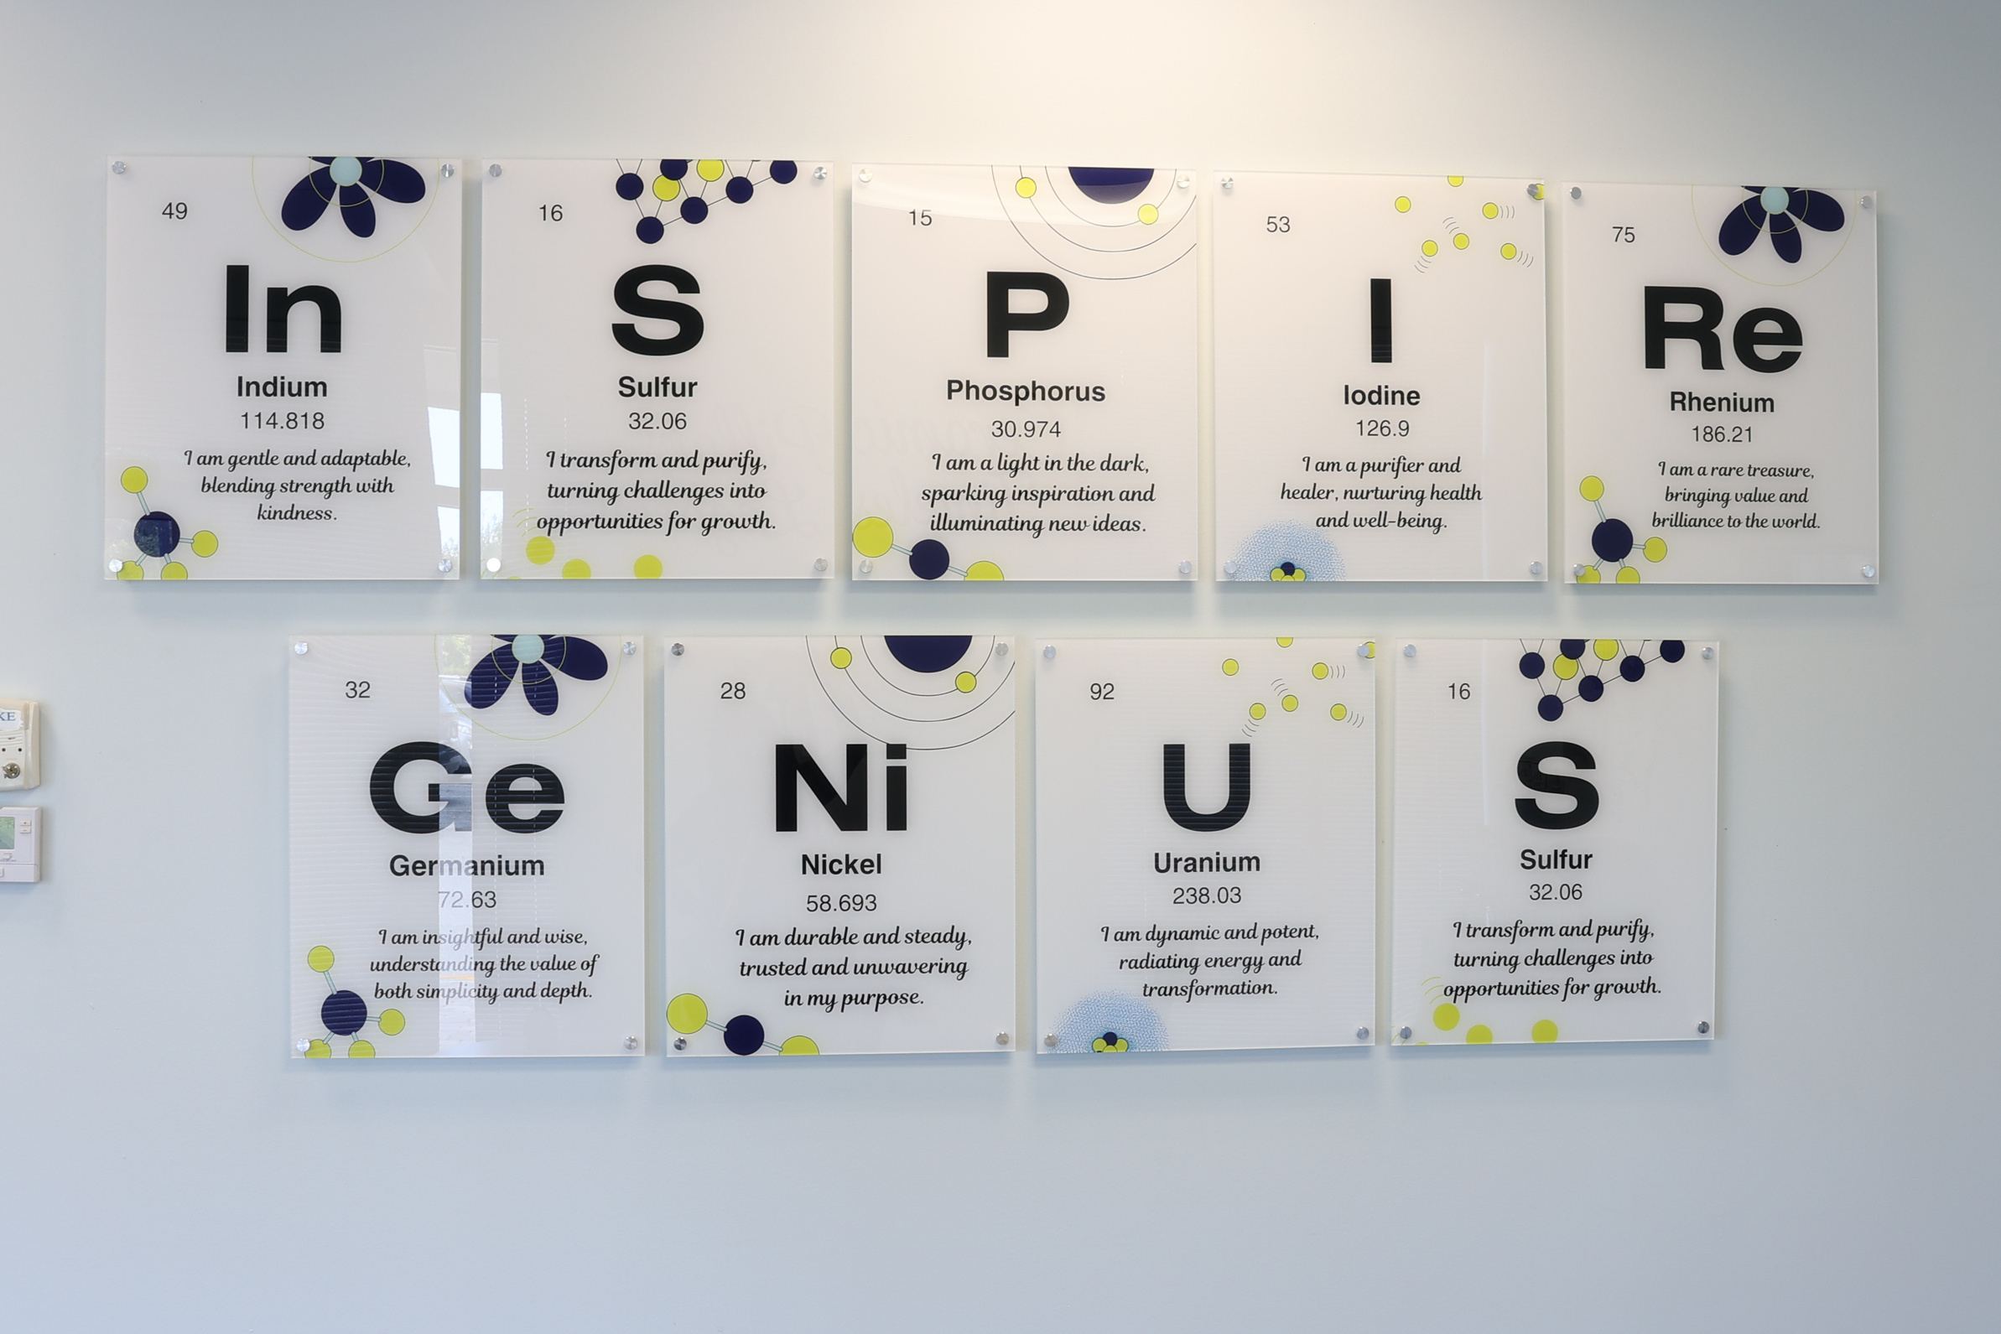
It’s not just Chemistry...it’s Curated Confidence.

Slide 24

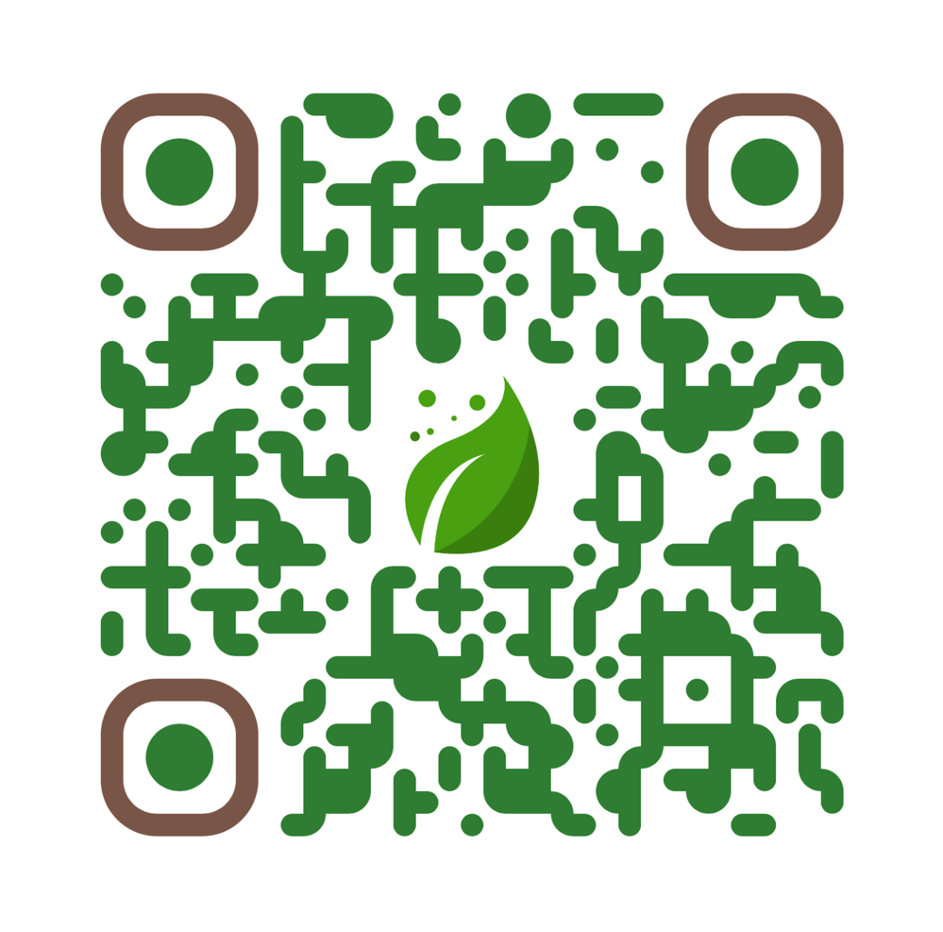
THANK YOU!
Access to The Voice of C.A.L.M.™ Resources
Instagram:
@thomasedlearningcenter
@periodicaffirmations

Slide 25

Dr. Deidre Reid-Thomas
Founder & CEO
Thomas Ed Learning Center & Periodic Affirmations™
FUNDERS & PARTNERS
EMAIL
DRT@thomasedsolutions.com
SPONSORS
PHONE NUMBER
(561) 235 - 3783

Slide 26
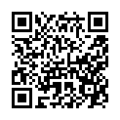

Evaluation

