Slide 1







Lighting the Way:
FUNDERS & PARTNERS
25 Years of Afterschool Excellence
Prime Time Palm Beach County
Afterschool Symposium 2026
SPONSORS
Powered by Youth Voice
Jessica Donner, Every Hour Counts
Anton Spaulding, Prime Time PBC
#AfterschoolSYM2026

Slide 2
Why Youth Voice?
What decisions are we making that impact young people?
Where could youth voice make our work stronger?
Where are we already hearing from youth and where are we not?
How can youth engagement help us advance equity in the work we do?

Slide 3
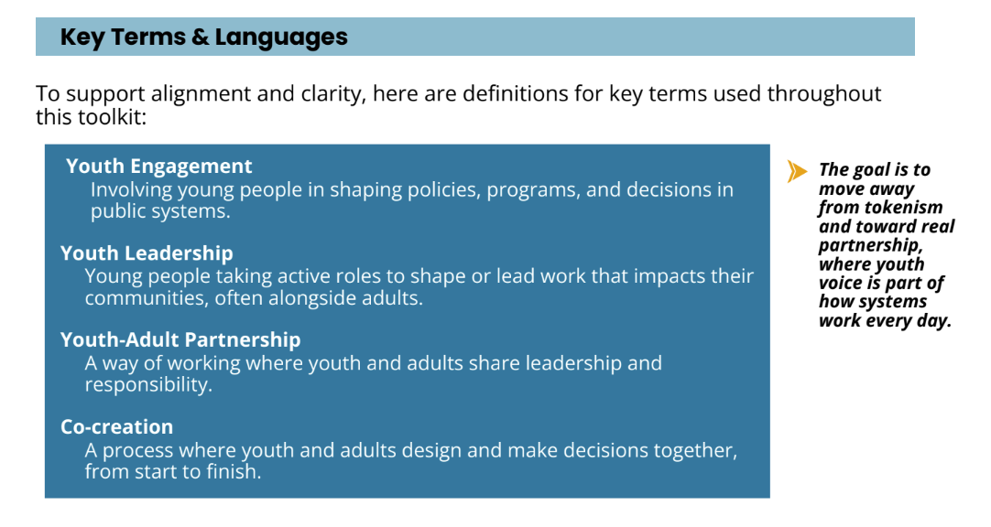
What do we mean by youth voice?

Slide 4



Powered by Youth Voice:
Future Directions for Afterschool
Notes:
Youth-driven survey

Slide 5
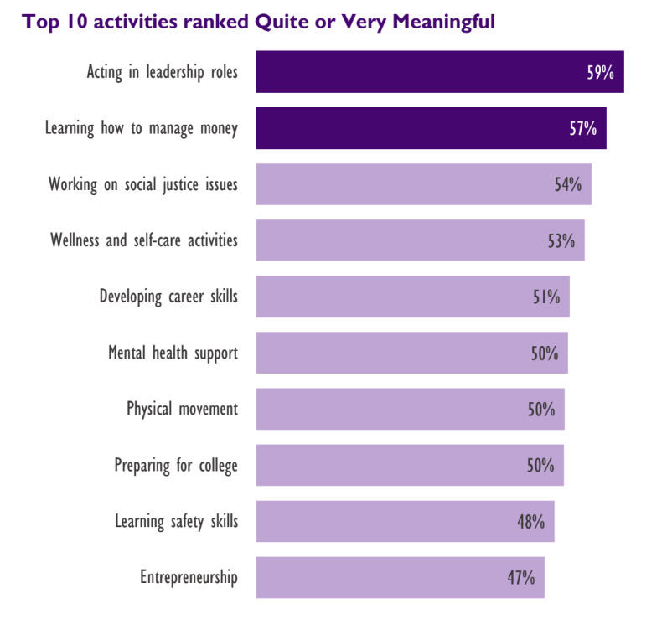
Survey findings

Slide 6
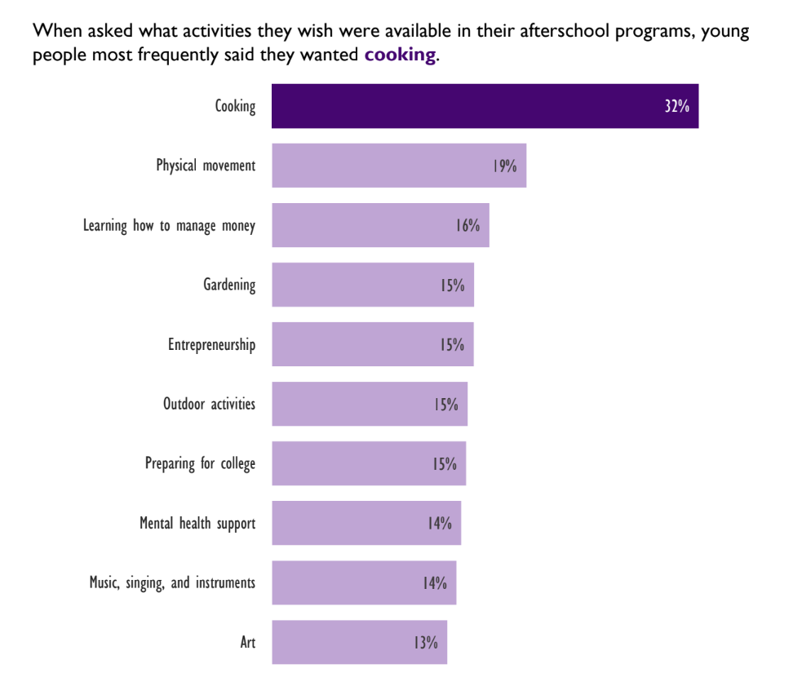

Slide 7



"You Would Feel the Love When You Walked In"
Youth Reimagine the Future of Afterschool Programs
Notes:
Key themes - coming soon!

Slide 8
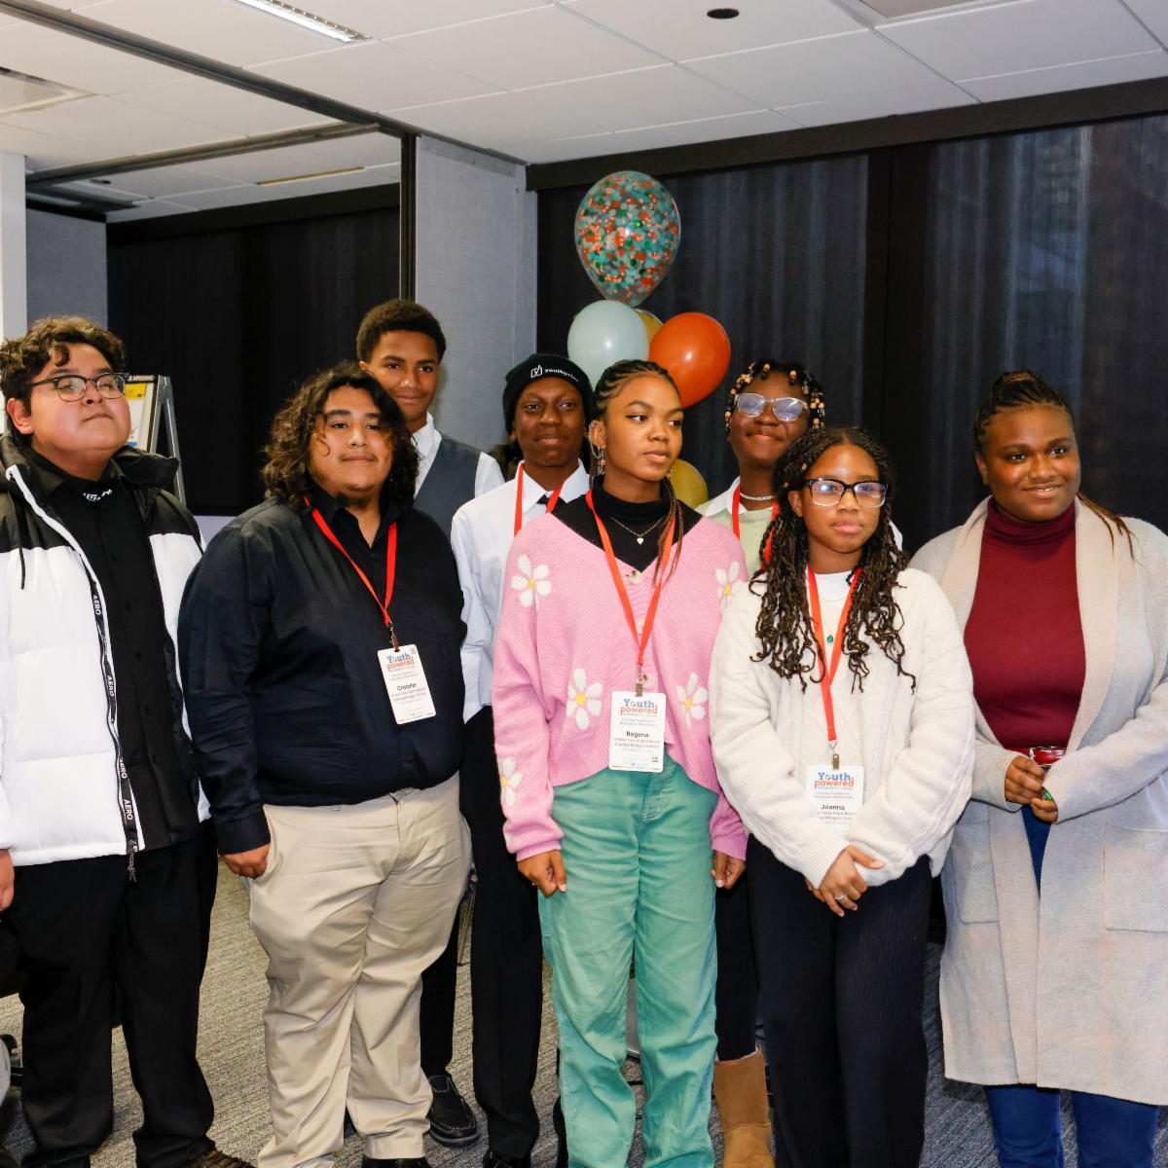
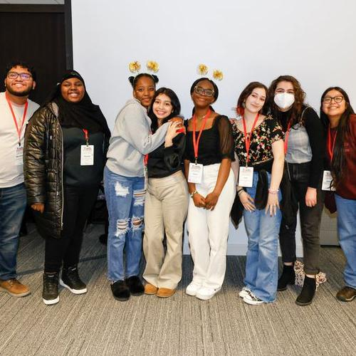
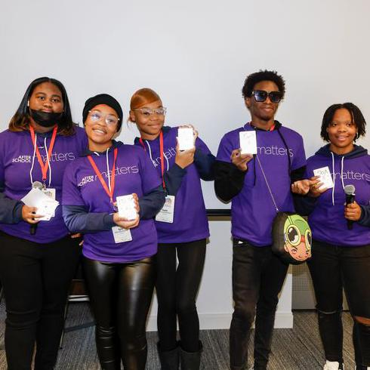



$10,000
Chicago, IL
Building the REC, a new youth-led afterschool space with focus on social and emotional learning, cultural awareness, performing arts, career coaching, financial literacy and postsecondary enrichment.
$10,000
Palm Beach County, FL
Designing Vivid Futures with arts-based college and career internships led by youth.
$25,000
Providence, RI
Youth-led summits and state-level advocacy focused on mental health, college and career readiness, and youth leadership structures.
8

Slide 9
What we’ve learned so far
Young people want leadership opportunities and spaces for healing – and want to be included in the designing of those spaces.
Youth led does not mean without adults. Young people understand the importance of adults and desire supportive adult role models.
Young people have incredible insights on systems and policies that impact them. They are more than capable of offering solutions to challenges they face.
Young people are experts in their experiences and deserve to be compensated for their stories, ideas, and labor.

Slide 10
What we’ve learned so far
Youth engagement work is equity work. We cannot authentically engage young people without challenging systems of power and oppression.
Choice is not enough. Young people want to be integral to all decision-making, implementation, evaluation, and feedback processes on issues that impact their communities.
Young people want to be viewed and treated as important decision-makers with the agency to drive programs, policy, and organizations.
Youth recognize that afterschool has the potential to be a transformative space where they can learn and grow.

Slide 11
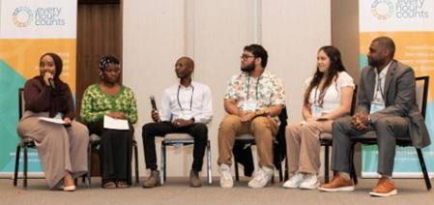
WHAT WE DID
Peer Learning and Networking
Challenge Event
Planning
Implementation
Lighting the Way:
25 Years of Afterschool Excellence
Prime Time Palm Beach County
Afterschool Symposium 2026
#AfterschoolSYM2026

Slide 12
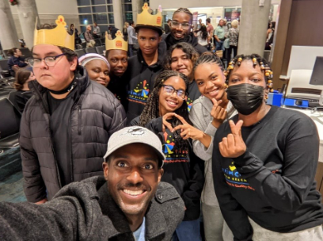
WHAT WE LEARNED
Listen
Collaborate
Compensate
Lighting the Way:
25 Years of Afterschool Excellence
Prime Time Palm Beach County
Afterschool Symposium 2026
#AfterschoolSYM2026

Slide 13
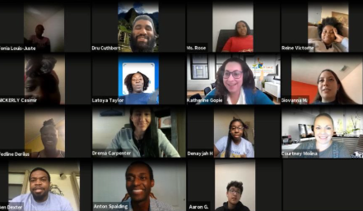
OUR PATH FORWARD
Professional
Development
Community
Connections
Youth
Advisory
Lighting the Way:
25 Years of Afterschool Excellence
Prime Time Palm Beach County
Afterschool Symposium 2026
#AfterschoolSYM2026

Slide 14
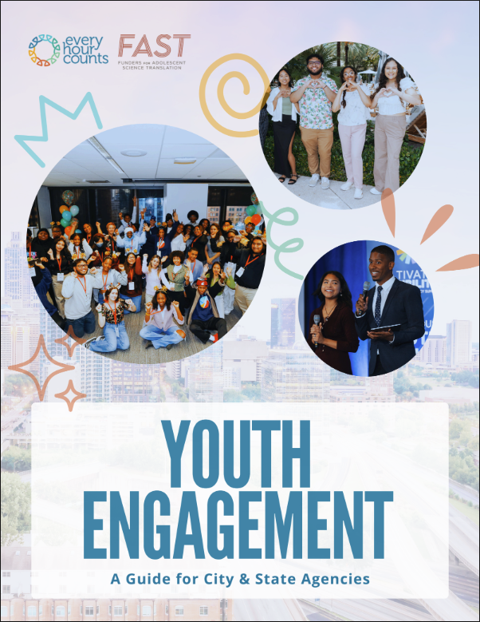
Youth Engagement: A Resource Guide

Slide 15
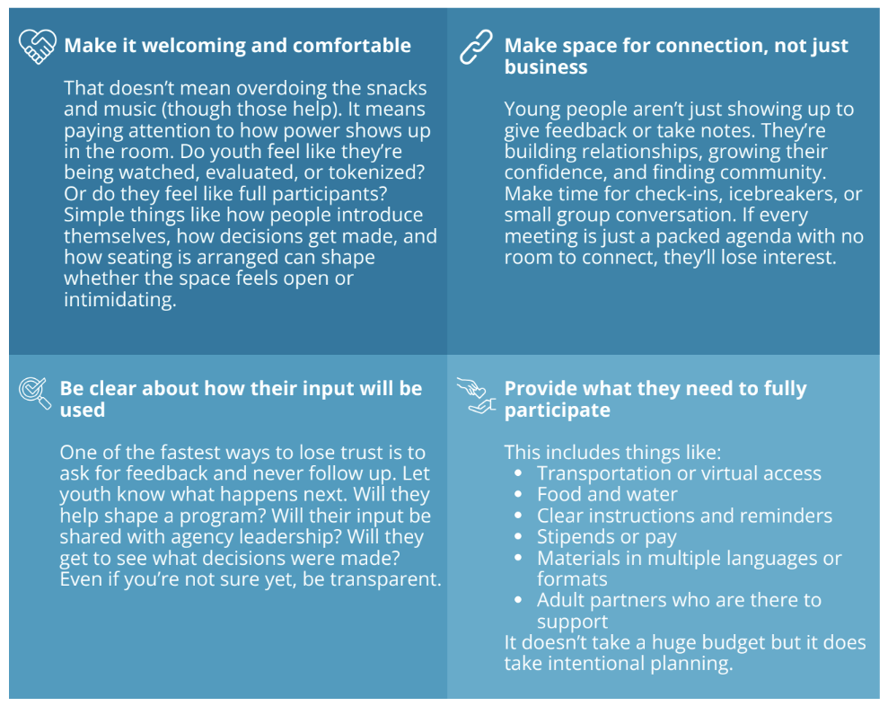
Creating Spaces Where Young People Want to Be
Notes:
Use chart page 5.

Slide 16
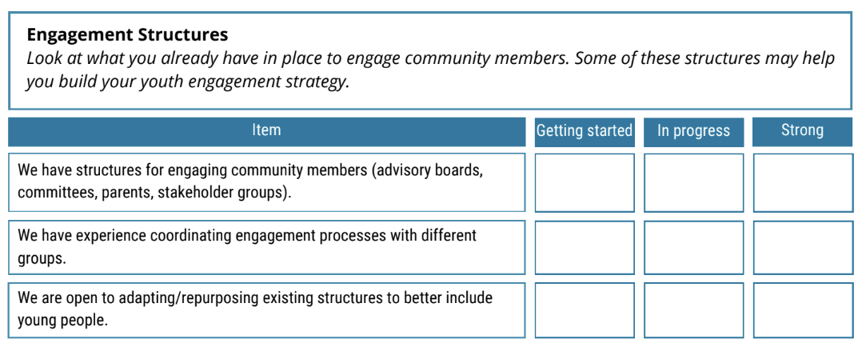
Youth Engagement Readiness Self-Assessment
Notes:
Page 22 - Print copies

Slide 17

Jessica Donner
Executive Director
Every Hour Counts
FUNDERS & PARTNERS
EMAIL
jdonner@everyhourcounts.org
SPONSORS
Anton Spalding
Professional Development Manager
Prime Time Palm Beach County
aspalding@primetimepbc.org

Slide 18
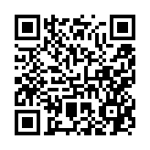

How did we do?
Thank you!

