Slide 1
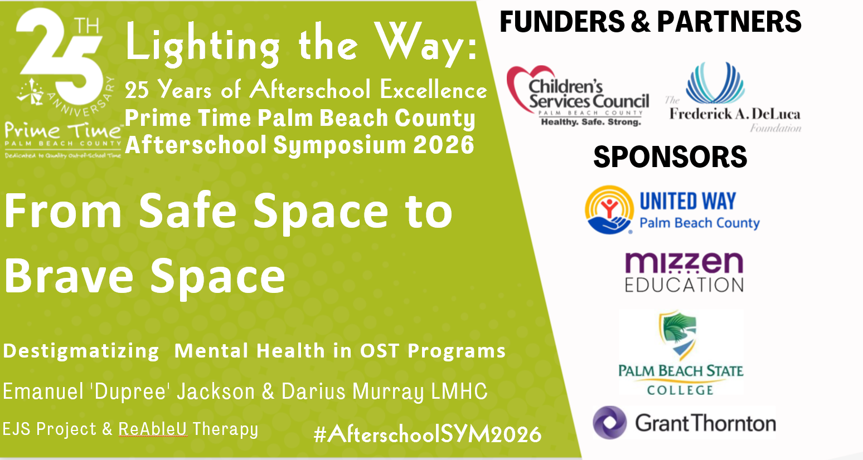

Slide 2
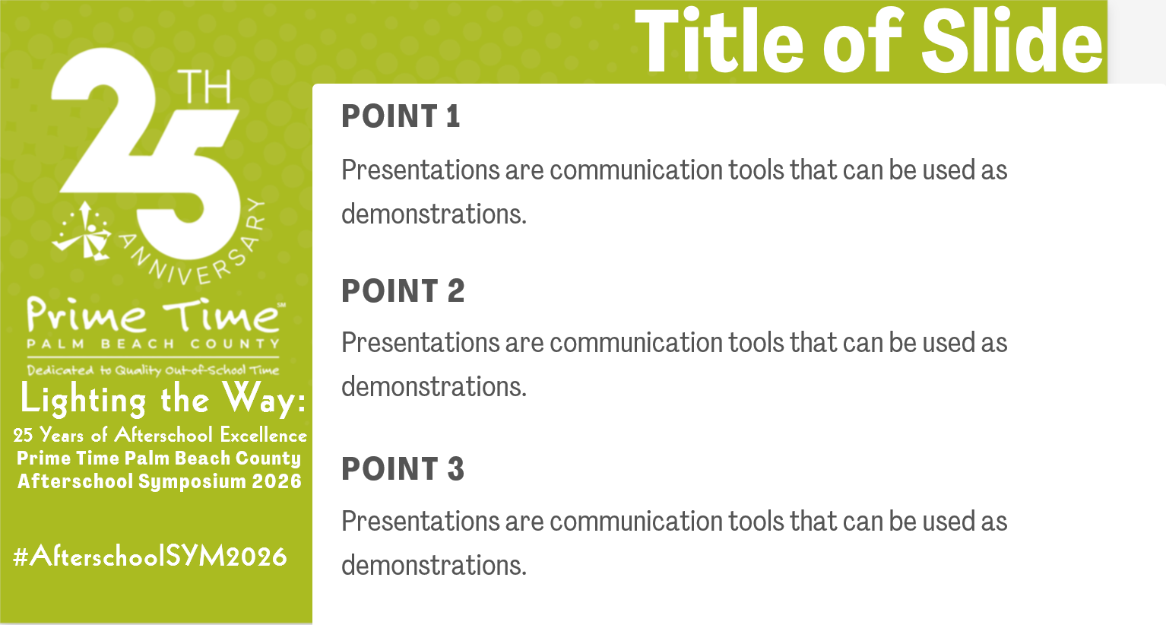

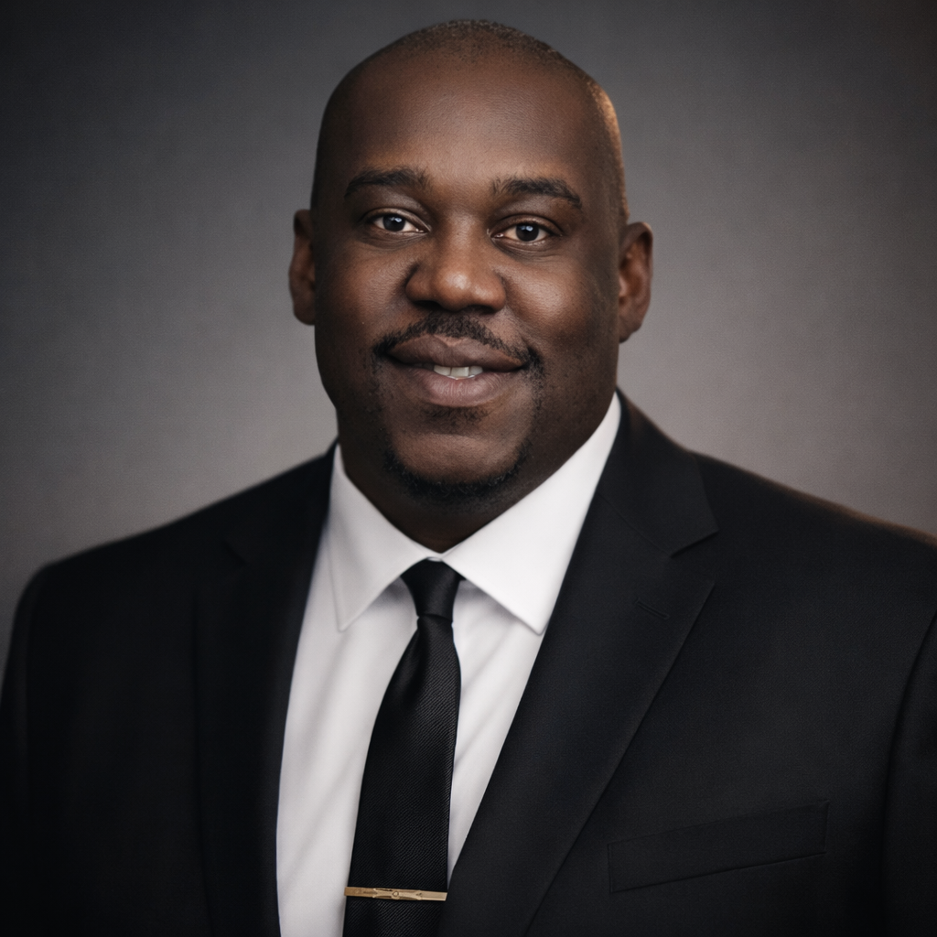
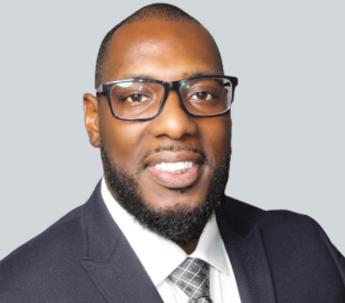
Introductions
Emanuel ‘Dupree’ Jackson
Founder & Executive Director
Emanuel Jackson Senior Project
Darius Murray LMHC
Founder
ReAbleU Therapy

Slide 3

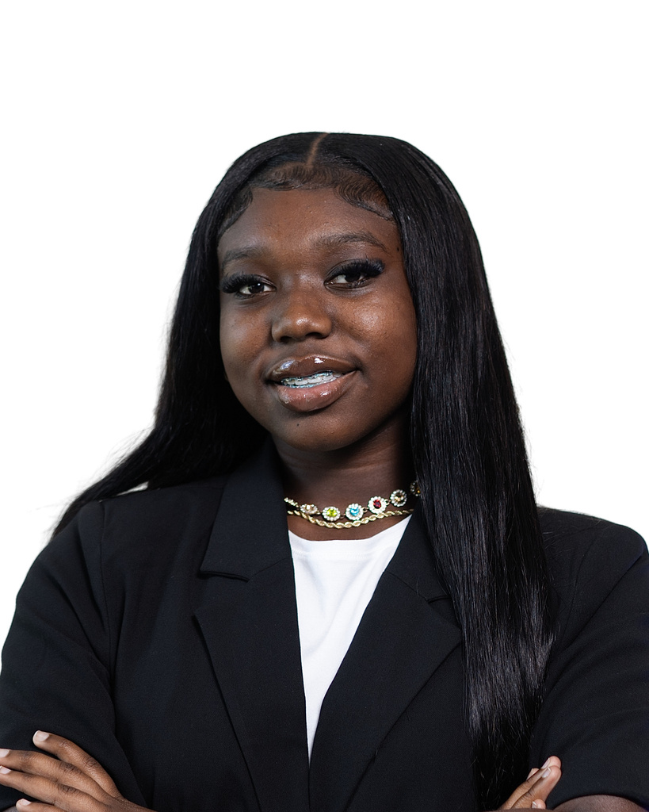
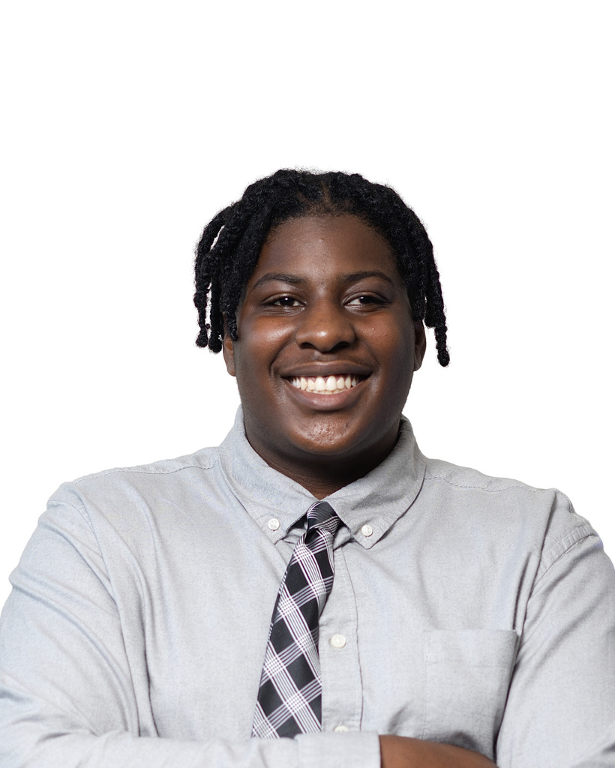
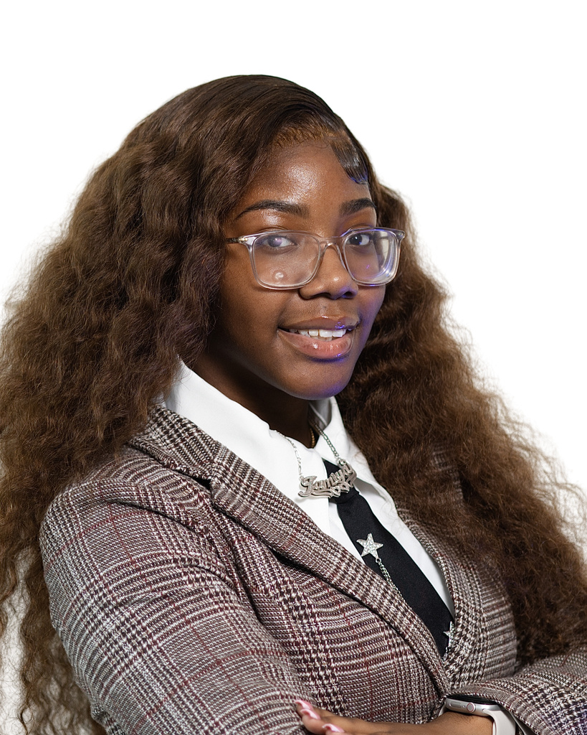
Introductions
Joeniseley Mathurin
Director of Operations
Emanuel Jackson Senior Project
Jazlyn Jackson
9th Grade
West Boca Raton Community High School
Patrick Madison
11th Grade
A.W.Dreyfoos School of the Arts
Ja’Miya Johnson
11th Grade
Santaluces Community High School

Slide 4
Introductions
Who’s in the Room
After School Practitioners
Upper Management
Board Level
Funder Level

Slide 5
Ice Breaker
Led By:

Slide 6
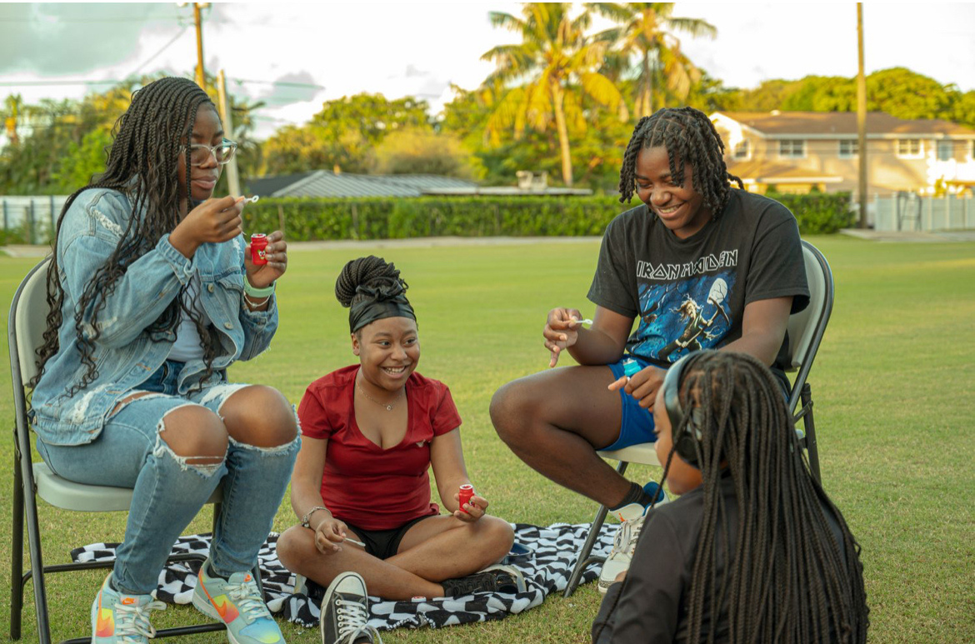


Building the
REAL SAFE SPACE
What helped us build the foundation?
Our Intake Process
The questions we ask
The SWOT Analysis

Slide 7
Building the
REAL SAFE SPACE
What helped us build the foundation?
Our Intake Process
The questions we ask
The SWOT Analysis

Slide 8
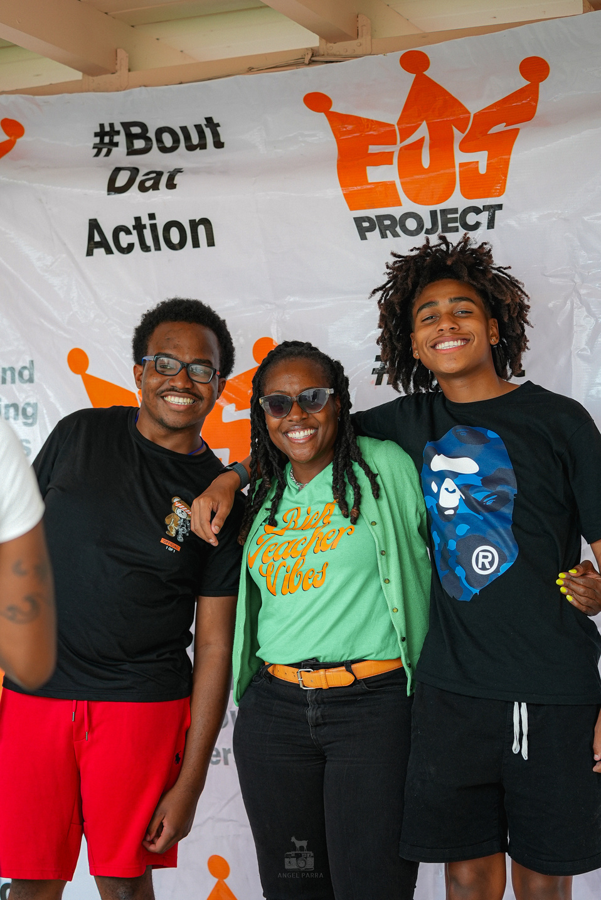





Our Intake Process
These are the questions we ask to all in attendance:
How did you hear about/learn about the EJS Project?
What do you know about us, and what do you hope to gain from participating in our program?
What would you say are some of the strengths that you (the student) or your student have?
What are some areas that you would like to see improvement?
Are you a part of/ involved in any other extracurricular activities?
Is there any particular program that sticks out to you that you would like to be a part of?
Internal SWOT Analysis
Strengths
What does the student do well?
What circumstances are currently working in the student’s favor right now?
Weaknesses
What does the student struggle with?
What circumstances are currently not working in the student’s favor right now?
Opportunities
What opportunities can we provide to the student to uplift their strengths and work on their weaknesses?
Threats
What circumstances in this student’s life can pose a threat to their success?
How can we be proactive to this situation?

Slide 9
Building the
REAL SAFE SPACE
Turn This Into Baseline Data

Slide 10
Building the
REAL SAFE SPACE
What helped us build the foundation?
Our Intake Process
The questions we ask
The SWOT Analysis
Collective Impact
Restorative Practices
REI (Racial Equity Institute)
Removing the Red Tape Strategically

Slide 11
Building the
REAL SAFE SPACE
Ask Yourself:
“Is your organization unintentionally stigmatizing mental health through policy?”
Some examples may include:
Strict no-contact policies
Fear-based liability thinking
Overly rigid communication rules

Slide 12

Building the
REAL SAFE SPACE
“Is your organization unintentionally stigmatizing mental health through policy?”
Other Orgs
Staff is not allowed to give me a hug, only high fives
They only ask how I’m doing when I’m upset or causing a disturbance
I don’t think the staff ever met my family
The staff doesn’t know where I live
I can’t be alone in a room with a staff member

Slide 13
Building the
REAL SAFE SPACE
“Is your organization unintentionally stigmatizing mental health through policy?”
EJS Project
Other Orgs
All staff gives me a hug everyday
They ask me how my day was
They know my family, and regularly communicate with them
They take me to my door when we’re running late from volunteering
If I need to talk to a staff alone I can
Staff is not allowed to give me a hug, only high fives
They only ask how I’m doing when I’m upset or causing a disturbance
I don’t think the staff ever met my family
The staff doesn’t know where I live
I can’t be alone in a room with a staff member

Slide 14






Building the
REAL SAFE SPACE
Love
Confidence & Pride
Positive reinforcement
Empathy & Validation
Open communication & active listening
Equity of Opportunity
Accountability
Confidentiality & Trust
Cultural Competence
Guidance
Meaningful Participation
Judgement Free Zone
A REAL SAFE SPACE
Creative Expression
Structure & Limits
Equity of Voice
Self-Definition
Clear boundaries & expectations
Social Connections
Access to support systems
A strong foundation with the family
An intentional intake process
Exposure
Responsiveness
Healthy Human Interaction
Positive Coping Strategies
Safe to fail
Academic Support

Slide 15
Last year we taught you how to build safety...now together we’ll build courage.

Slide 16
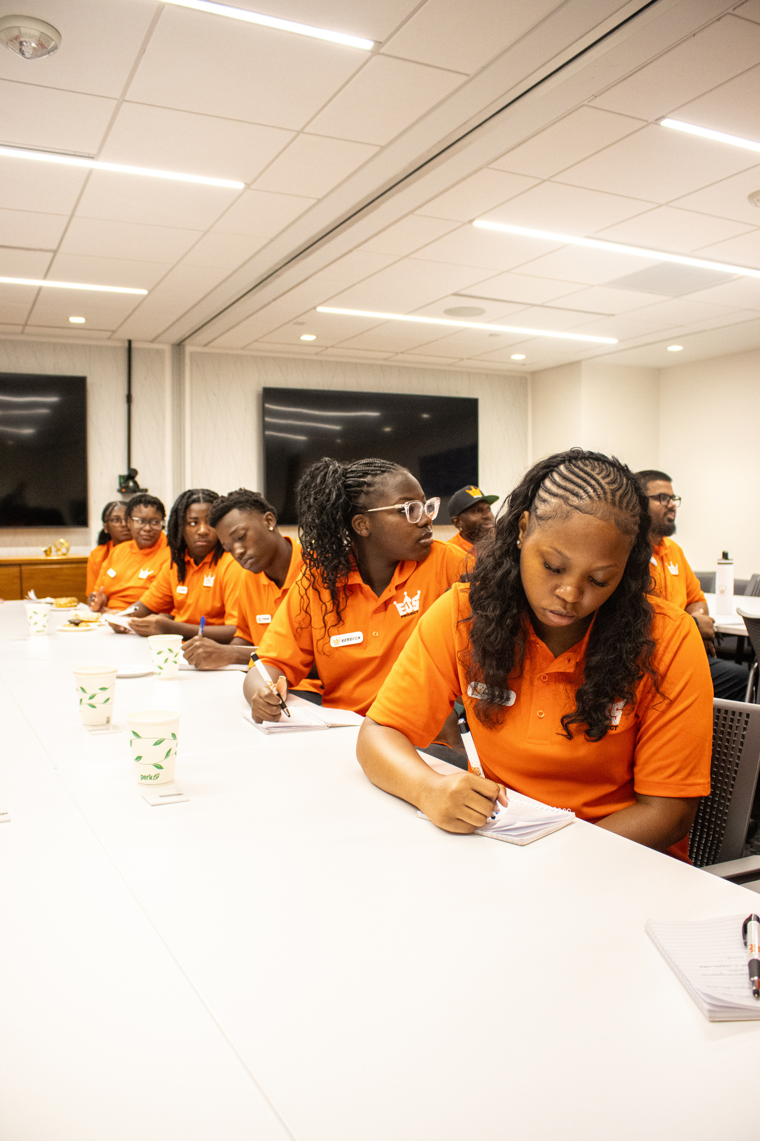
What We’re Facing
Depression
Between 2016 and 2023, the prevalence of diagnosed depression increased 45 percent (from 5.8% to 8.4%) among 12-17 year olds.
Anxiety
Also between 2016 and 2023, the prevalence of diagnosed anxiety increased 61 percent (from 10.0% to 16.1%) among 12-17 year olds.
Suicidality
Among US high school students in 2023, 20% reported seriously considering attempting suicide, 16% reported making a suicide plan, and 9% reported attempting suicide.
Unmet Mental Health Needs
Only 51% of youth (6-17) with a mental health condition get treatment in a given year.

Slide 17
What We’re Facing
Activity: Table Topic
What would happen if a student would disclose a suicide ideation or thoughts tomorrow?
Do you have a plan? Does your staff feel equipped?
Would you feel nervous or unprepared?
Talk amongst your table for 5 minutes and choose one person to be prepared to share the group’s thoughts, feelings, fears, concerns, and reflections that come up during the discussion.

Slide 18

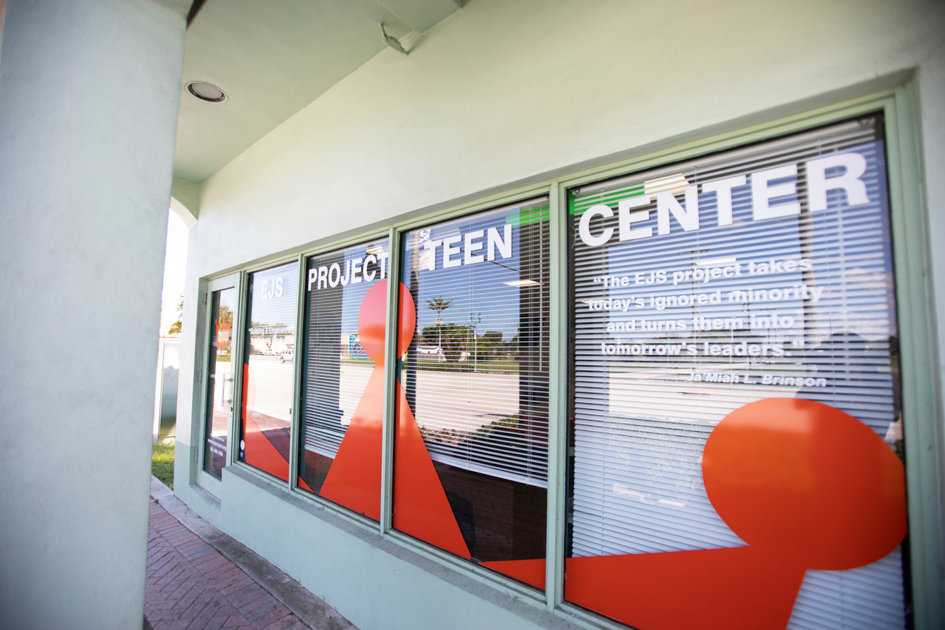
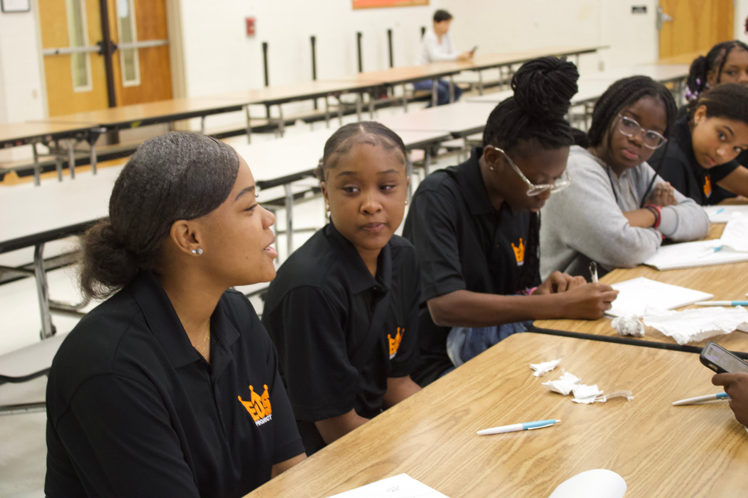
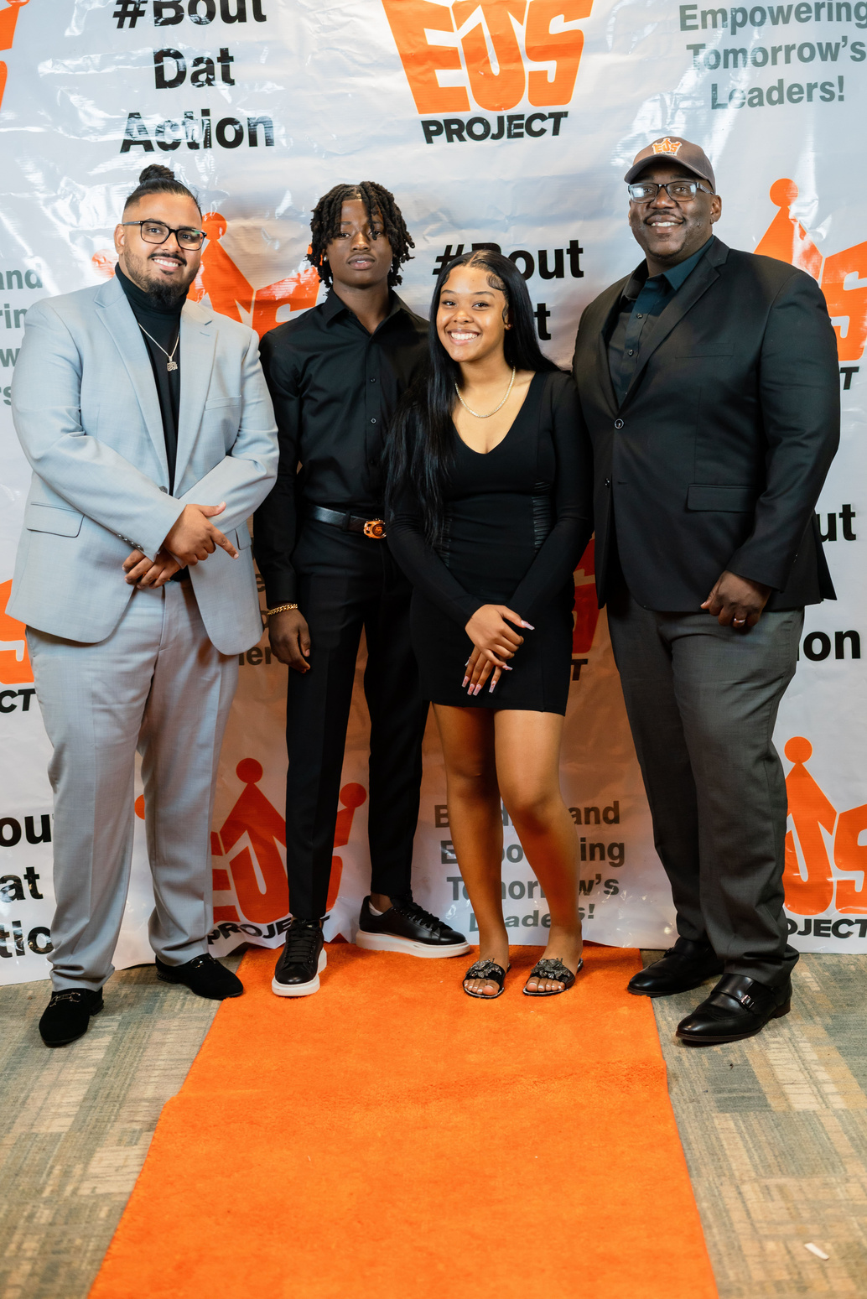
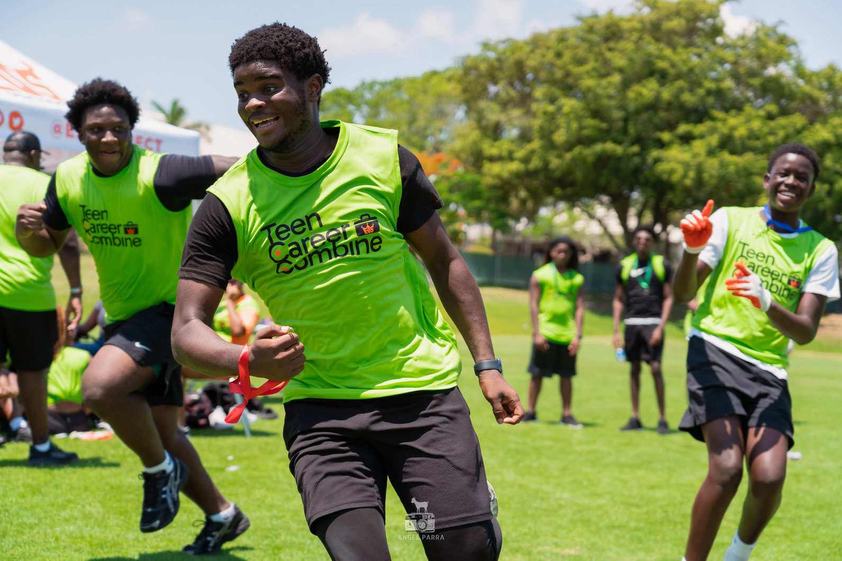
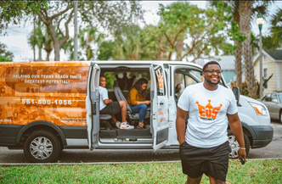
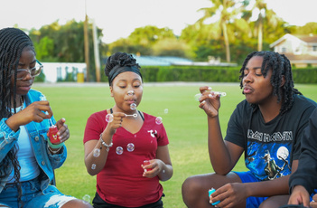
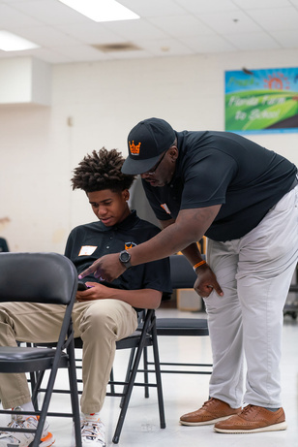

How We Started
The Timeline 2021 - Present
Spring 2022
Spring 2023
Fall 2024
Responded to the growing need by connecting struggling students to 1-1 therapy
Formed partnership with ReAbleU Therapy and launched the EmpowerU Mental Health Program
Approached to create a learning model for other youth organizations to launch their own mental health program
Spring 2021
Fall 2022
Summer 2023
Present Day
Student opens up about their suicide attempt
Received feedback from participating students that they weren’t connecting with their therapists
Featured in a county wide story on the Well of PBC to give our perspective on helping youth navigate mental health based on the success of EmpowerU
100+ Teens in PBC have been connected to high quality mental health services
What is the EmpowerU Mental Health Program?
Monthly clinician-led “Growth and Reflection Workshops”
Focus on emotional skills & safe space development
Free access to one-on-one therapy for students & families in need of extra support

Slide 19

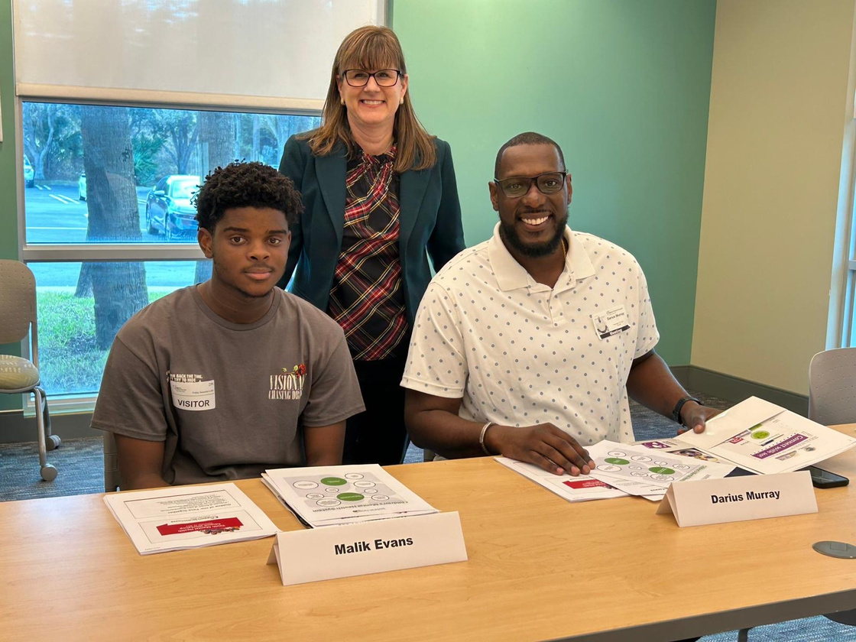
Prepping for Each Session
Early Partnership Approach:
Initially, EJS provided suggested topics and conversation prompts to guide each session.
Now – Community-Driven:
With time at EJS, I now understand our students, culture, and needs — shaping sessions based on what resonates most.
Every Session Includes Movement and a thought provoking question:
Sessions are built around reflective, engaging prompts that spark honest dialogue. Activities are intentionally designed to get students engaged, interacting, and physically active.
Psychoeducation Matters:
We integrate learning moments (e.g., understanding cortisol levels and the body’s stress response).
Our Session Framework:
Relevant Topic & Discussion → Interactive Activity → Education & Reflection
Meet Students Where They Are:
Flexibility is key. When a compliment circle became the primary activity, we embraced the moment rather than forcing the agenda.

Slide 20







Program Implementation
Before Launch
After Launch - Maintaining Success
Build the foundation
Finding therapists who reflect our students’ backgrounds.
Strategic partnerships (ReAbleU Therapy, community resources).
Consistently create a stigma-free culture for youth and parents.
Continue to diversify, try not to make it stale
Check ins and communication with your therapist is paramount to the success of the program
Darius Murray is usually our first call
We don’t reach out when it’s too late
The EmpowerU Pipeline
The EmpowerU Mental Health Program is introduced during the intake meeting, often sparking interest from the student or family and planting the seed as an available support option.
Student then attends monthly Growth & Reflection Workshops and is exposed to discussions and activities around mental health
Students and families see him at family nights, on our social medias, and at some events that he can make it to.
Outcome 1
Outcome 2
Outcome 3
Outcome 4
A drastic event happens in the student’s life
Heightened emotional intelligence, no intervention necessary
Student opens up and identifies their need
Staff/therapist hears a red flag during the session
Student reaches out to staff or therapist for help
Staff approaches student and family, sometimes therapy is the outcome.
Student or family brings to staff’s attention that something has happened. EJS then responds with communication and understanding. Sometimes therapy is the outcome.
Student attends monthly Growth & Reflection Workshops but does not need further help with their mental health.

Slide 21
The Panel
Jazlyn Jackson
9th Grade
West Boca Raton Community High School
Patrick Madison
11th Grade
A.W.Dreyfoos School of the Arts
Ja’Miya Johnson
11th Grade
Santaluces Community High School

Slide 22
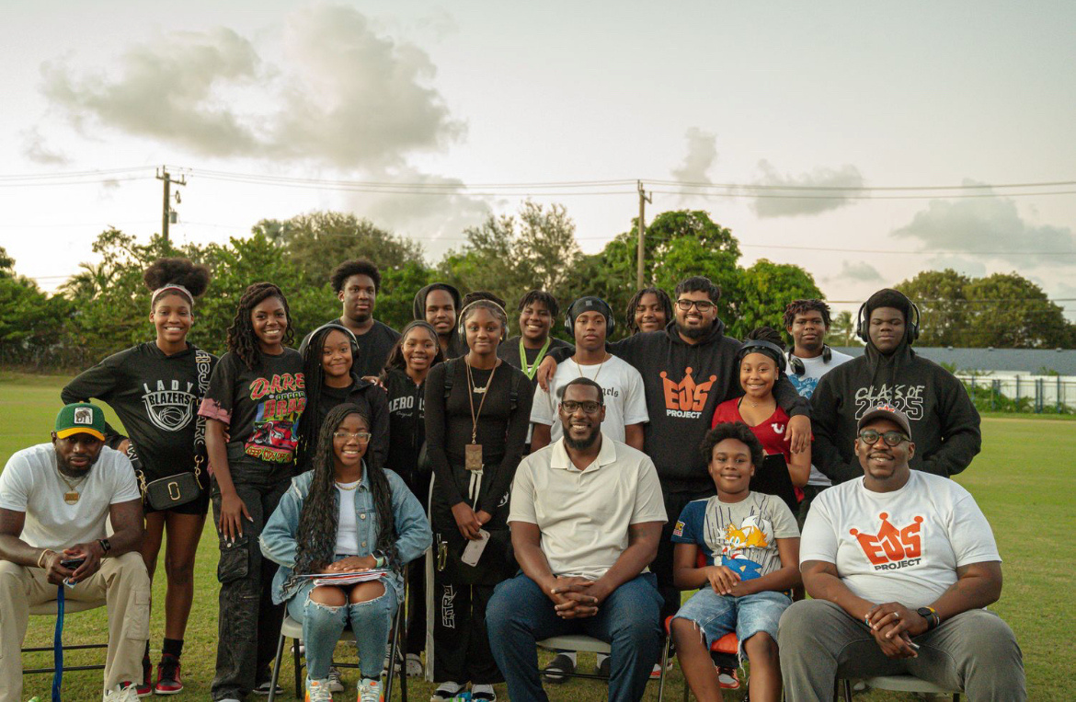
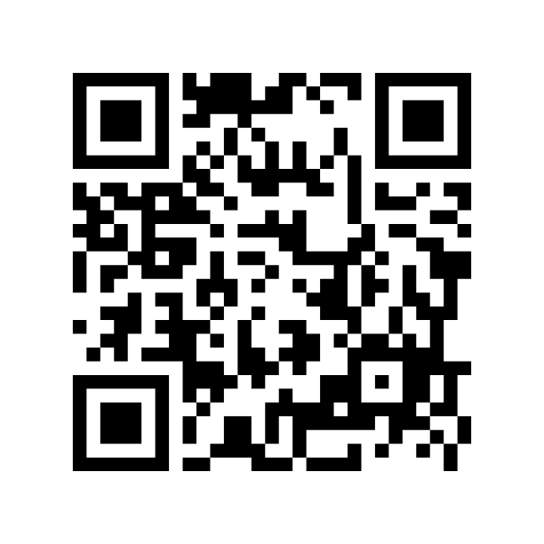
Thank you!
Any Questions?
SCAN TO SIGN UP TO RECEIVE THE EMPOWERU LEARNING MODEL FOR FREE!
LEARN MORE HERE:
www.ejsproject.org
www.reableutherapy.com
l
@ejs_project
@reableutherapy
l

Slide 23
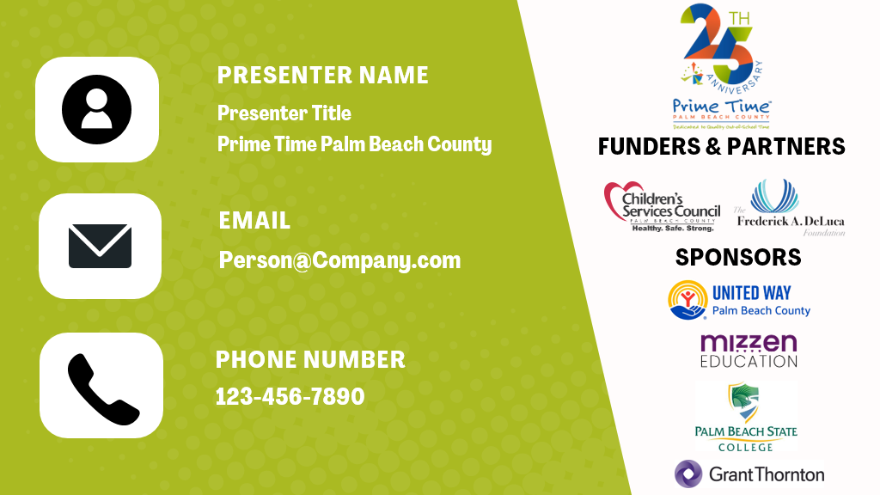

EMANUEL ‘DUPREE’ JACKSON
FOUNDER & EXECUTIVE DIRECTOR, EJS PROJECT
DARIUS MURRAY LMHC
FOUNDER, REABLEU THERAPY
EMANUEL.JACKSON@EJSPROJECT.ORG
DARIUS@REABLEUTHERAPY.COM
DUPREE: 561-706-2650
DARIUS: 305-753-5554

Slide 24

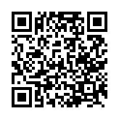
Scan to Complete the Workshop Survey

