Slide 1








Lighting the Way:
FUNDERS & PARTNERS
25 Years of Afterschool Excellence
Prime Time Palm Beach County
Afterschool Symposium 2026
SPONSORS
Healing-Centered Leadership: Supporting Youth by Supporting the Adults Who Serve Them
Tessie Watts, M.Sc.
The Leadership Haven Resource Center LLC
#AfterschoolSYM2026

Slide 2
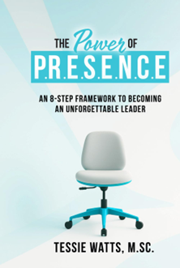
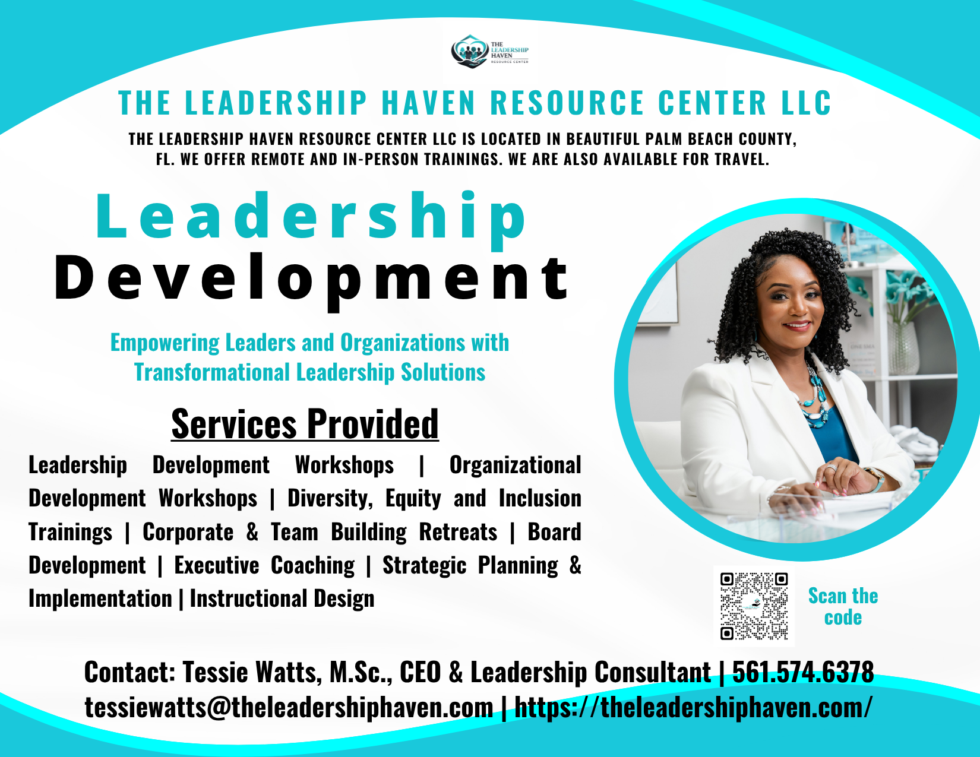
Your Facilitator
Lighting the Way:
25 Years of Afterschool Excellence
Prime Time Palm Beach County
Afterschool Symposium 2026
#AfterschoolSYM2026

Slide 3

Session Overview
I. Where Pressure Lives in Our Work
II. The Foundation of Healing-Centered Engagement
III. Defining Healing-Centered Leadership
Power Move 1: Regulate Yourself First
Power Move 2: Create Predictability for Others
Power Move 3: Lead from Strength, Not Survival
IV. Applying the Work in Real-Time Leadership Moments
Lighting the Way:
25 Years of Afterschool Excellence
Prime Time Palm Beach County
Afterschool Symposium 2026
#AfterschoolSYM2026

Slide 4




Activity #1: Where PRESSURE Lives
1. What does pressure look like here? (What’s actually happening?)
2. How do you typically respond in that moment? (Be honest, not ideal)
3. How do you want to respond instead? (If you had full control of your leadership capacity)
Lighting the Way:
25 Years of Afterschool Excellence
Prime Time Palm Beach County
Afterschool Symposium 2026
#AfterschoolSYM2026

Slide 5
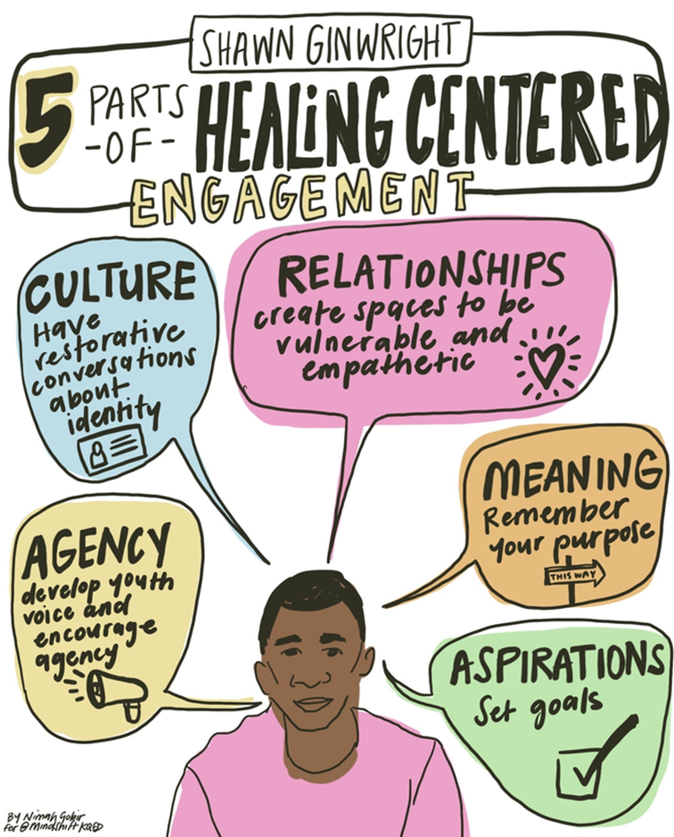
Dr. Shawn Ginwright
HEALING-CENTERED ENGAGEMENT
Created as a response to trauma-informed approaches.
Distinction in simple terms:
Trauma-informed → asks: “What happened to you?”
Healing-centered → asks: “What’s right with you, and how do we build from that?”
Lighting the Way:
25 Years of Afterschool Excellence
Prime Time Palm Beach County
Afterschool Symposium 2026
#AfterschoolSYM2026

Slide 6


THE 5 CORE ELEMENTS OF HEALING-CENTERED ENGAGEMENT
1. Asset-Driven (Strength-Based)
3. Culturally Grounded
2. Holistic
Recognizes that people are complex → Healing isn’t one-dimensional; leadership must consider the whole person.
Focuses on what’s right with people, not just what they’ve been through.
People feel seen when who they are is acknowledged and valued.
4. Collective (Not Just Individual)
5. Adult & Provider Well-Being
Healing happens in relationships, community, and connection, not in isolation.
Those who serve others must also be supported and well.
→ You cannot sustain impact if the leader is depleted.

Slide 7

IN THE WORK THAT YOU DO…
You are constantly pouring into others.
Rarely are you asked…
“What is this work requiring from you, and what is it taking from you?”

Slide 8


When leaders are depleted…
Responses become reactive
Consistency breaks down
Environments become unpredictable

Slide 9
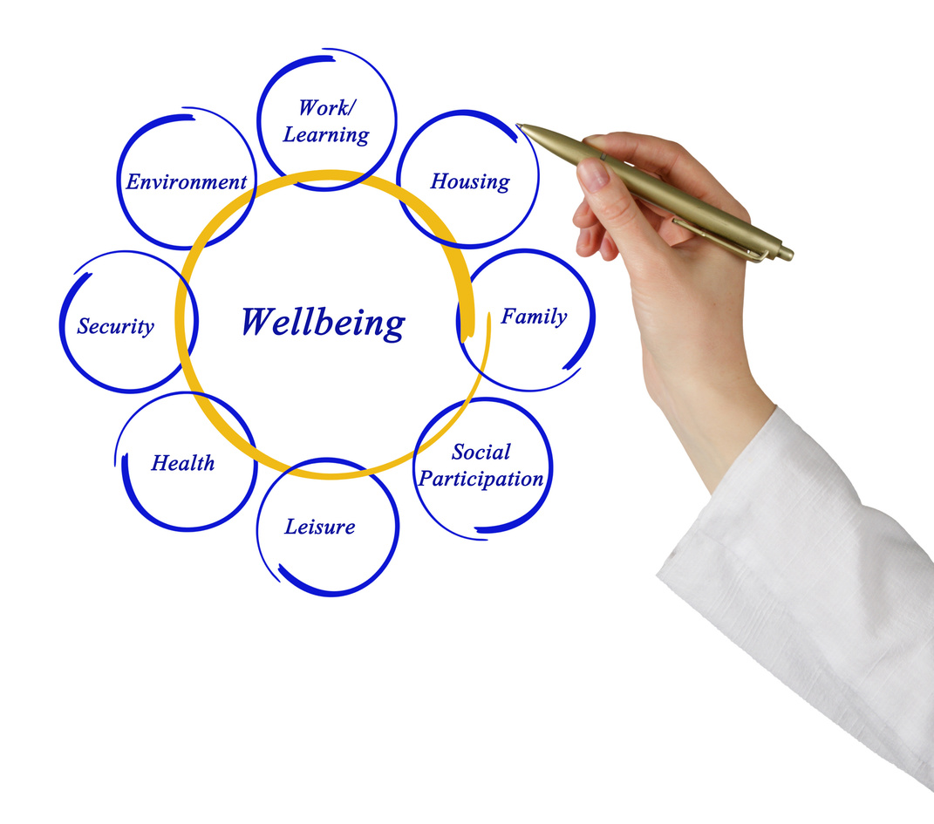
Your well-being is not separate from the work… it is essential to the work.

Slide 10

Healing-Centered Leadership
Healing-Centered Leadership is the ability to recognize pressure, stay aware of your response, and choose a leadership stance that creates stability, trust, and forward movement.

Slide 11




WHEREEVER THERE IS
PRESSURE
THERE’S SOME LEVEL OF
POWERPLAY
POWER MOVE 1:
REGULATE YOURSELF FIRST
POWER MOVE 2:
POWER MOVE 3:
LEAD FROM STRENGTH, NOT SURVIVAL
CREATE PREDICTABILITY FOR OTHERS

Slide 12
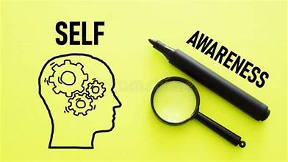
POWER MOVE 1: REGULATE YOURSELF FIRST
You cannot lead a moment well
if you haven’t first led yourself in that moment.

Slide 13

POWER MOVE 1: REGULATE YOURSELF FIRST
“Regulation before Resolution.”
Lighting the Way:
…if you are dysregulated, overwhelmed, frustrated, or triggered…
your response is no longer intentional.
It’s Automatic!
25 Years of Afterschool Excellence
Prime Time Palm Beach County
Afterschool Symposium 2026
#AfterschoolSYM2026

Slide 14
POWER MOVE 1: REGULATE YOURSELF FIRST
“Regulation before Resolution.”
Regulation is not about ignoring your emotions.
It’s about being aware enough of what’s happening internally…
so you can choose how you show up externally.
Lighting the Way:
25 Years of Afterschool Excellence
Prime Time Palm Beach County
Afterschool Symposium 2026
#AfterschoolSYM2026

Slide 15

POWER MOVE 1: REGULATE YOURSELF FIRST
“Regulation before Resolution.”
Once you regulate yourself…
you now have access to choice.
And that’s where your POWER comes in.
Lighting the Way:
25 Years of Afterschool Excellence
Prime Time Palm Beach County
Afterschool Symposium 2026
#AfterschoolSYM2026

Slide 16



POWER MOVE 1: REGULATE YOURSELF FIRST
Concept 1:
Power Up
Powering Up → I step into authority, provide direction, make my voice clear
Power Down
Powering Down → I shift my stance to disarm, build trust, and move the situation forward

Slide 17


POWER MOVE 1: REGULATE YOURSELF FIRST
Concept 1:
Both are intentional.
Both are leadership.
But you can’t access either one clearly… without Regulation FIRST.
Power Up
Power Down
The 3-Step Reset
1. Pause
“What am I feeling right now?”
2. Name It
“What is this situation triggering in me?”
3. Choose Your Stance
“Does this moment require me to Power Up or Power Down?”

Slide 18

SCENARIO 1: “Public Pushback” (Staff)
Situation: You give a direction to your team, and one staff member responds in front of others| “That’s not how we usually do it.”
SCENARIO 2: “Student Escalation” (Youth)
Situation: A student becomes loud, disruptive, and says| “You can’t tell me what to do!”
SCENARIO 3: “Last-Minute Demand” (Administration)
Situation: You are already managing multiple responsibilities, and you’re told | “We need you to handle this today.”
SCENARIO 4: “Parent Confrontation” (Parents/Families)
Situation: A parent approaches you at pickup, visibly upset, and says | “I don’t like how you handled my child today. This is not okay.”(Other parents and children are nearby.)

Slide 19

POWER MOVE 2: CREATE PREDICTABILITY FOR OTHERS
“People thrive in environments they can predict.”
Brain Science: Predictability Reduces Threat
From neuroscience (work by David Rock and others): The brain is constantly scanning for threat vs. safety
Uncertainty = threat response
Predictability = safety response
“The brain performs better when it knows what’s coming.”
Youth Development Insight
In youth development environments, young people thrive with:
structure
consistency
clear expectations
Why? Because predictability:
reduces behavioral escalation
increases trust with adults
improves participation
“Students don’t just respond to rules; they respond to consistency.”
Lighting the Way:
25 Years of Afterschool Excellence
Prime Time Palm Beach County
Afterschool Symposium 2026
#AfterschoolSYM2026

Slide 20
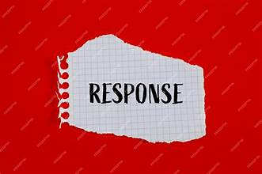

POWER MOVE 2: CREATE PREDICTABILITY FOR OTHERS
“People thrive in environments they can predict.”
=
What Are You Teaching People to Expect?

Slide 21

POWER MOVE 2: CREATE PREDICTABILITY FOR OTHERS
“People thrive in environments they can predict.”
Once you regulate yourself… people begin to experience you differently.
But here’s what matters even more,
they don’t just experience you once.
“They experience you consistently.”
Lighting the Way:
25 Years of Afterschool Excellence
Prime Time Palm Beach County
Afterschool Symposium 2026
#AfterschoolSYM2026

Slide 22
POWER MOVE 2: CREATE PREDICTABILITY FOR OTHERS
“People thrive in environments they can predict.”
Level 1: Inclusion Safety
I feel seen. I feel accepted. I feel like I belong here. “If people don’t feel included… they won’t engage.”
Level 2: Learner Safety
I feel safe to ask questions, try, and even get it wrong. “If people are afraid to learn… they stay silent.”
Level 3: Contributor Safety
I feel confident enough to add value and use my voice. “If people don’t feel valued… they hold back.”
Level 4: Challenger Safety
I feel safe to speak up, offer ideas, and challenge respectfully. “If people don’t feel safe to challenge… growth stops.”
Concept 2:
Lighting the Way:
25 Years of Afterschool Excellence
Prime Time Palm Beach County
Afterschool Symposium 2026
#AfterschoolSYM2026

Slide 23
POWER MOVE 2: CREATE PREDICTABILITY FOR OTHERS
“People thrive in environments they can predict.”
It’s built in patterns.
How you respond
How you communicate
How you follow through
Psychological safety is not built in big moments.
Lighting the Way:
25 Years of Afterschool Excellence
Prime Time Palm Beach County
People feel safe when they know what to expect from you.
Afterschool Symposium 2026
#AfterschoolSYM2026

Slide 24
POWER MOVE 2: CREATE PREDICTABILITY FOR OTHERS
“People thrive in environments they can predict.”
How I Show Up…
Missed Responsibilities
Late Pickup
Disrespectful Tone
Angry Parent
Last-Minute Changes
Micromanaging
What Are You Teaching People to Expect?
Lighting the Way:
25 Years of Afterschool Excellence
Prime Time Palm Beach County
Afterschool Symposium 2026
#AfterschoolSYM2026

Slide 25
POWER MOVE 2: CREATE PREDICTABILITY FOR OTHERS
“People thrive in environments they can predict.”
How I Show Up…
Missed Responsibilities
Late Pickup
Disrespectful Tone
Angry Parent
Last-Minute Changes
Micromanaging
If your responses consistently create fear, hesitation, or confusion…
People stop showing up fully.
But if your responses create clarity, trust, and respect…
They engage.
If you were on the receiving end of you…what would your response trigger?
Lighting the Way:
25 Years of Afterschool Excellence
Prime Time Palm Beach County
Afterschool Symposium 2026
#AfterschoolSYM2026

Slide 26

POWER MOVE 2: CREATE PREDICTABILITY FOR OTHERS
“People thrive in environments they can predict.”
The question is not just ‘How did I respond?’
The real question is ‘What did my response produce?’”
Lighting the Way:
25 Years of Afterschool Excellence
Prime Time Palm Beach County
You are shaping the environment through every interaction
Afterschool Symposium 2026
#AfterschoolSYM2026

Slide 27

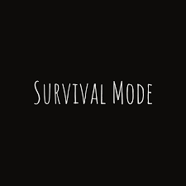

POWER MOVE 3: LEAD FROM STRENGTH, NOT SURVIVAL
“You cannot create stability for others if you are operating in survival.”
Healing-Centered Leadership asks:
How do I stay whole while doing this work… so I can lead in a way that creates stability, trust, and forward movement?
Lighting the Way:
25 Years of Afterschool Excellence
Prime Time Palm Beach County
Afterschool Symposium 2026
#AfterschoolSYM2026

Slide 28
POWER MOVE 3: LEAD FROM STRENGTH, NOT SURVIVAL
“You cannot create stability for others if you are operating in survival.”
Survival mode in leadership looks like this:
• Reacting instead of choosing
• Overextending instead of setting limits
• Absorbing everything instead of managing/leading it
• Leading from urgency instead of intention
Lighting the Way:
25 Years of Afterschool Excellence
Prime Time Palm Beach County
Afterschool Symposium 2026
#AfterschoolSYM2026

Slide 29

POWER MOVE 3: LEAD FROM STRENGTH, NOT SURVIVAL
Concept 3:
Boundaries as Leadership
“You cannot create stability for others if you are operating in survival.”
Boundaries are what protect your capacity to show up consistently.
Without them…
• You become inconsistent
• You become reactive
• You become depleted
And we already talked about what that does to safety.

Slide 30

POWER MOVE 3: LEAD FROM STRENGTH, NOT SURVIVAL
Concept 3:
Boundaries as Leadership
“You cannot create stability for others if you are operating in survival.”
How quickly capacity gets depleted
Why boundaries are essential to Healing-Centered Leadership
CAPACITY

Slide 31

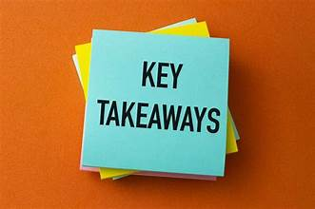
Boundaries are not a personal preference; they are a leadership responsibility.
1. Boundaries Protect Your Capacity to Lead
Every step you took forward represented something you carried.
2. Depleted Leaders Create Unstable Environments
Creating safety for self and others is the cornerstone of your leadership capacity.
3. Boundaries Are How You Maintain Consistency
It’s about protecting how you show up in the work.
FUNDERS & PARTNERS
POWER MOVE 3: LEAD FROM STRENGTH, NOT SURVIVAL
SPONSORS

Slide 32

So when the moment comes…
You regulate yourself first
(You don’t react; you become aware)
You create predictability for others
(You become someone people can trust and rely on)
Lead from strength, not survival
(You protect your capacity so you can keep showing up well)
FUNDERS & PARTNERS
Healing-Centered Leadership: Supporting Youth by Supporting the Adults Who Serve Them
SPONSORS

Slide 33
What This Means for the Youth You Serve
You regulate yourself first
(They learn how to manage emotions by watching you)
You create predictability for others
(They feel safe enough to participate and engage)
Lead from strength, not survival
(They experience a leader who is present, not depleted)
FUNDERS & PARTNERS
Healing-Centered Leadership: Supporting Youth by Supporting the Adults Who Serve Them
SPONSORS

Slide 34

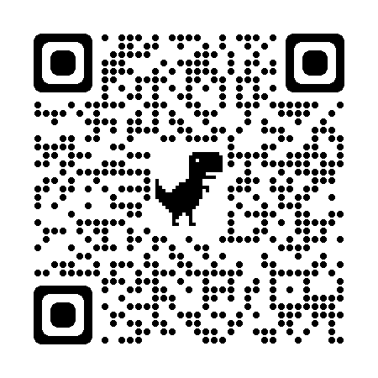

TESSIE WATTS, M.SC.
CEO
THE LEADERSHIP HAVEN RESOURCE CENTER LLC
FUNDERS & PARTNERS
EMAIL
admin@theleadershiphaven.com
SPONSORS
PHONE NUMBER
561-574-6378

Slide 35
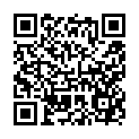


Healing-Centered Leadership: Supporting Youth by Supporting the Adults Who Serve Them
SURVEY QR CODE

