Slide 1









FUNDERS & PARTNERS
Prime Time Palm Beach County
Afterschool Symposium 2026
SPONSORS
Beyond Supervision:
What Out-of-School Time Can Become for Young People
Dr. Cassondra Corbin-Thaddies & Andre Thaddies
Connect to Greatness, Inc.
#AfterschoolSYM2026

Slide 2
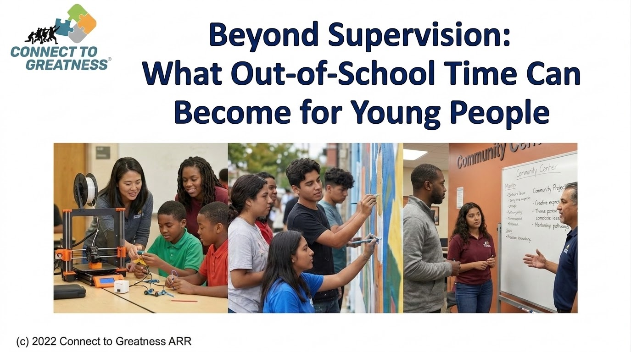

Notes:
Beyond Supervision: What Out-of-School Time Can Become for Young People

Slide 3


Slide 4
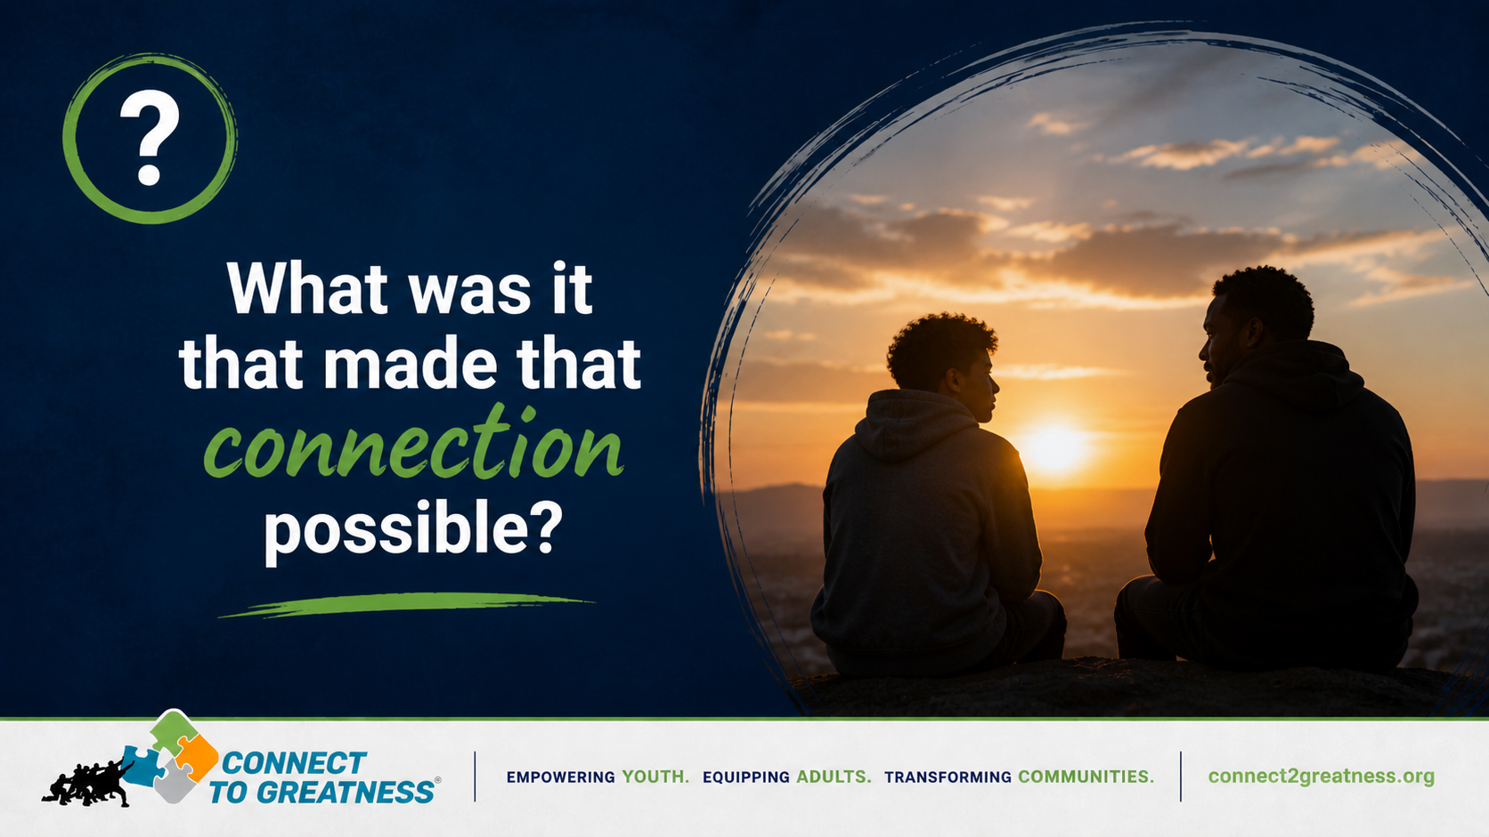

Slide 5
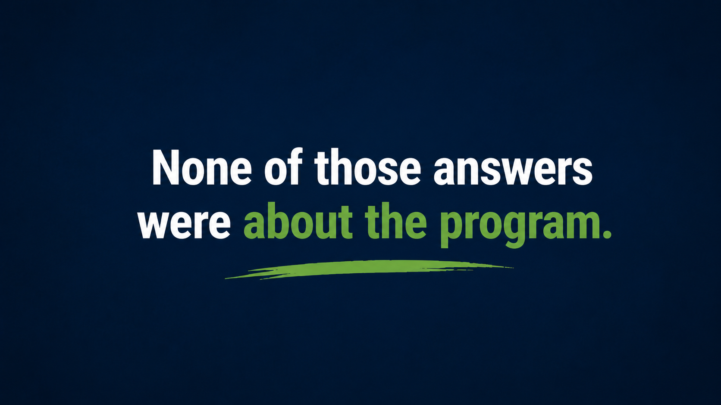

Slide 6
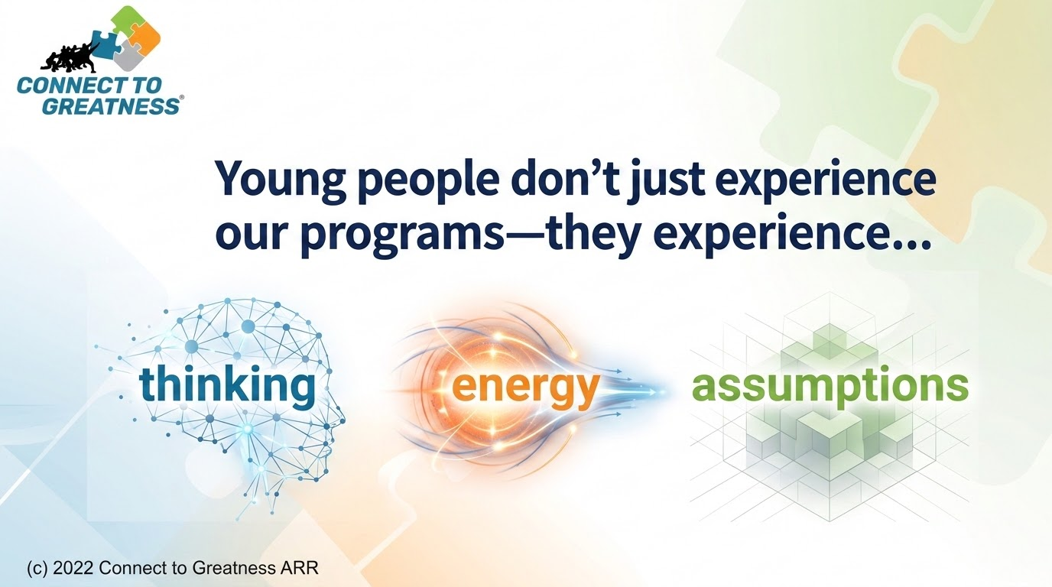

Slide 7
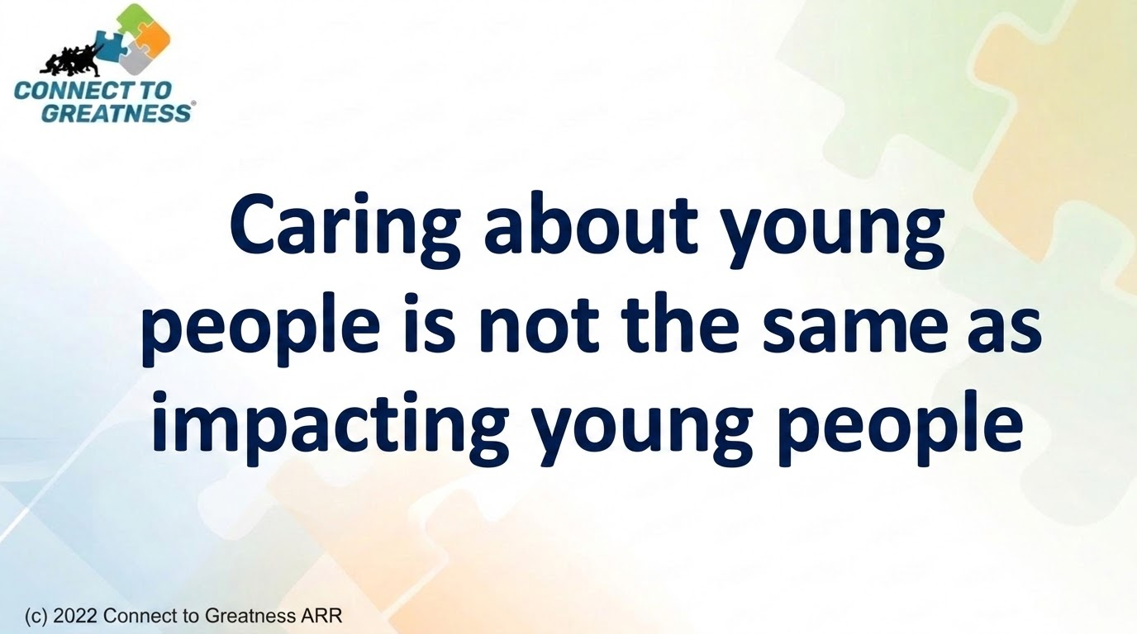

Slide 8
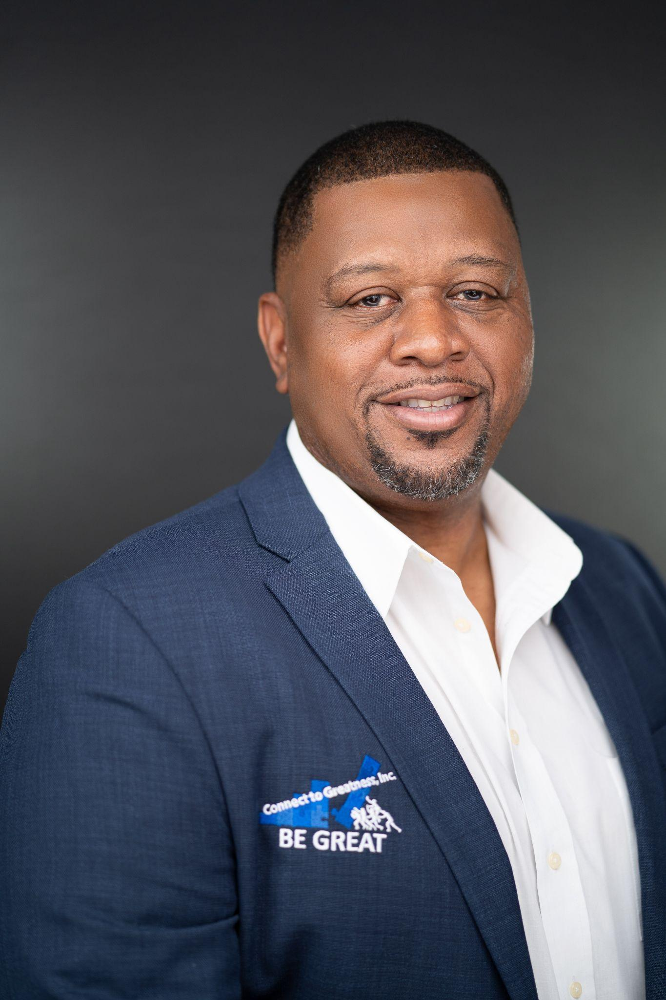
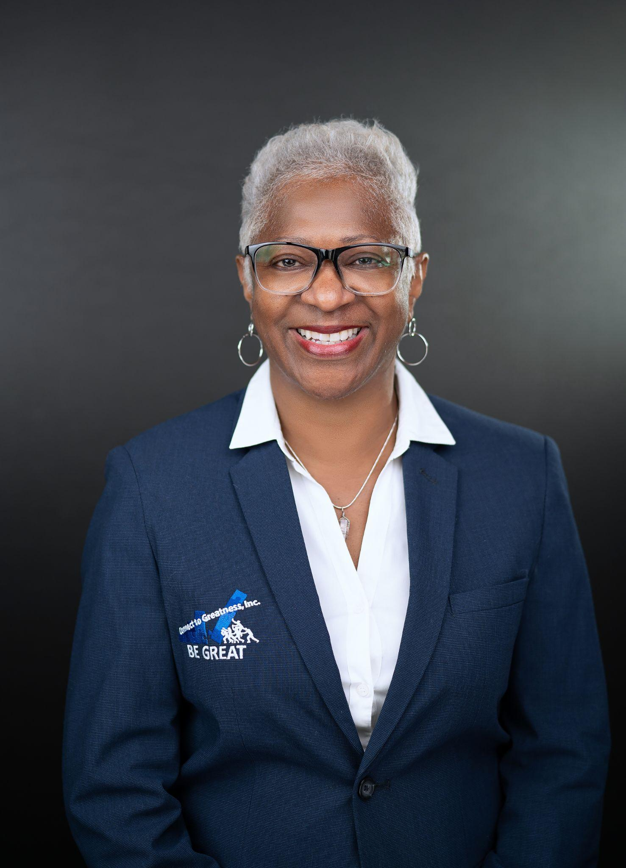

Andre Thaddies, Executive Director
Dr. Cassondra Corbin-Thaddies
Founder

Slide 9
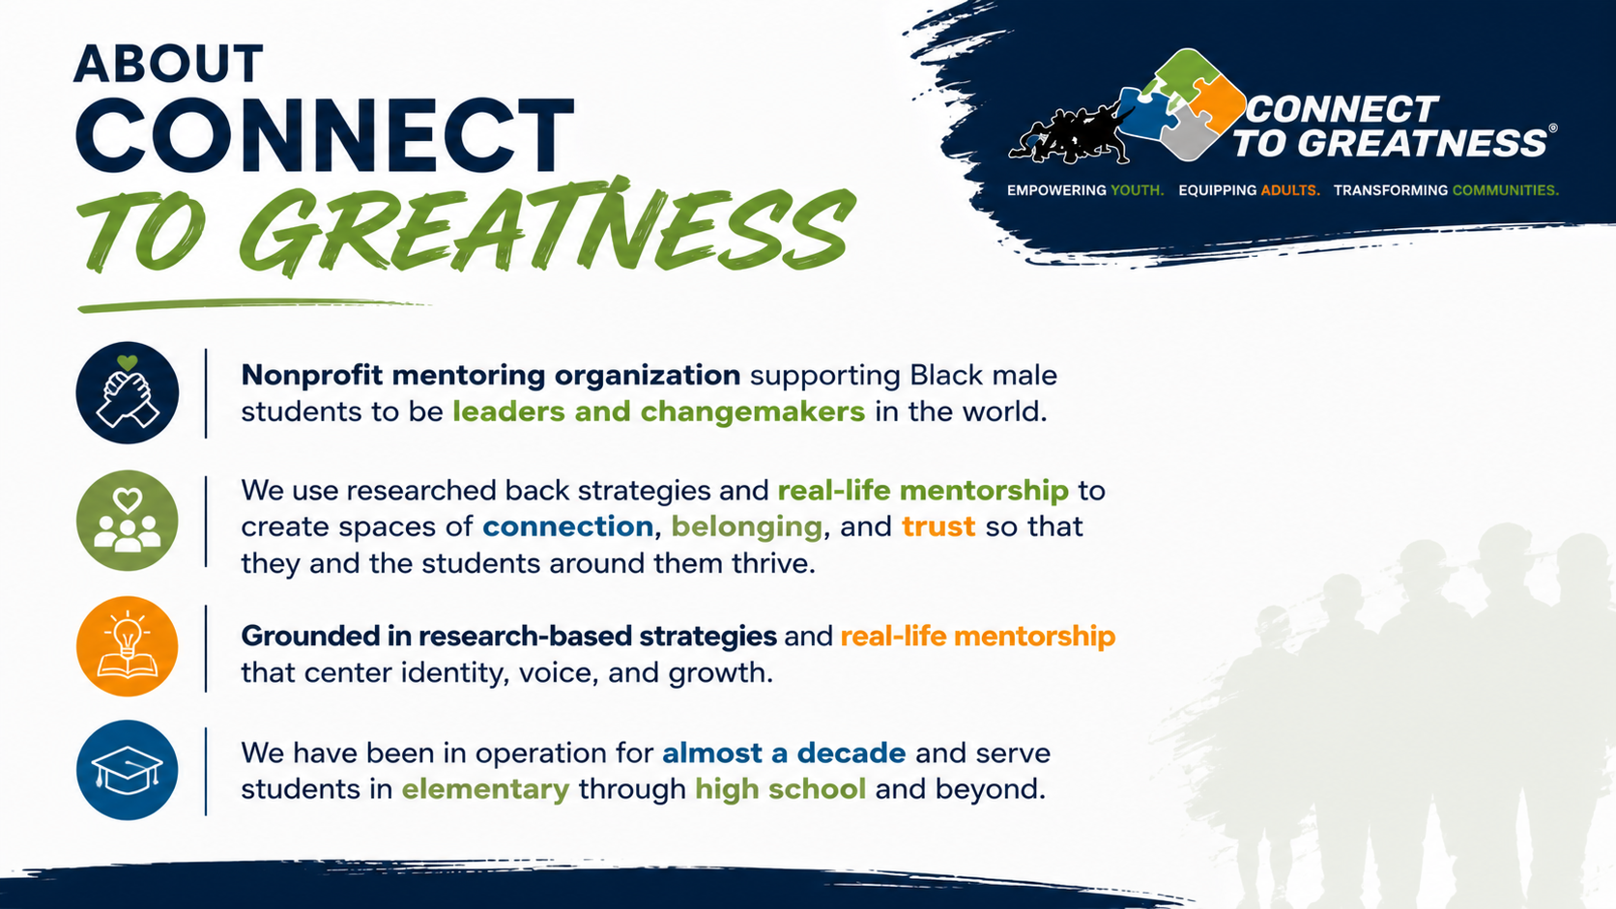

Slide 10


Slide 11
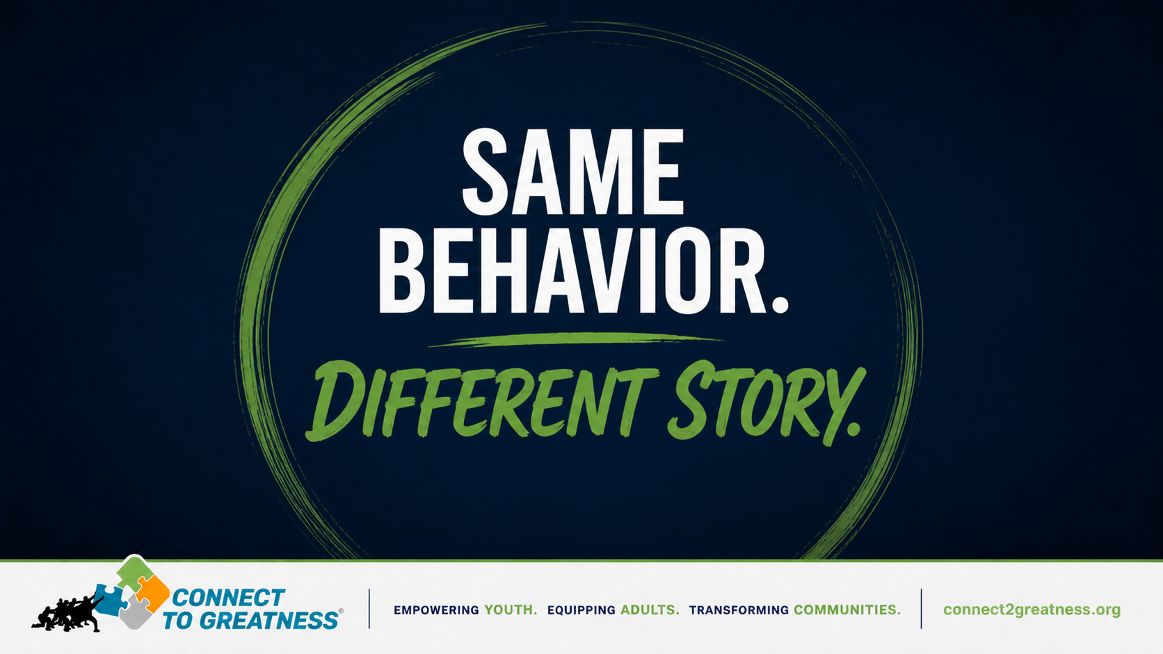

Slide 12
The Scene:
You are in an afterschool program.
The group is already engaged in an activity.
You invite a young person to join.

Slide 13
Second Pass

Slide 14
The Scene:
You are in an afterschool program.
The group is already engaged in an activity.
You invite a young person to join.

Slide 15
Partner Reflection
Person B shares first:
What did it feel like the first time?
What felt different the second time?
Person A shares:
What did you notice about yourself?
What changed in how you showed up?

Slide 16


Slide 17

Notes:
Participants WRITE using:
What am I thinking?
Where is that coming from?
How do I want to show up instead?
👉 Partner share

Slide 18
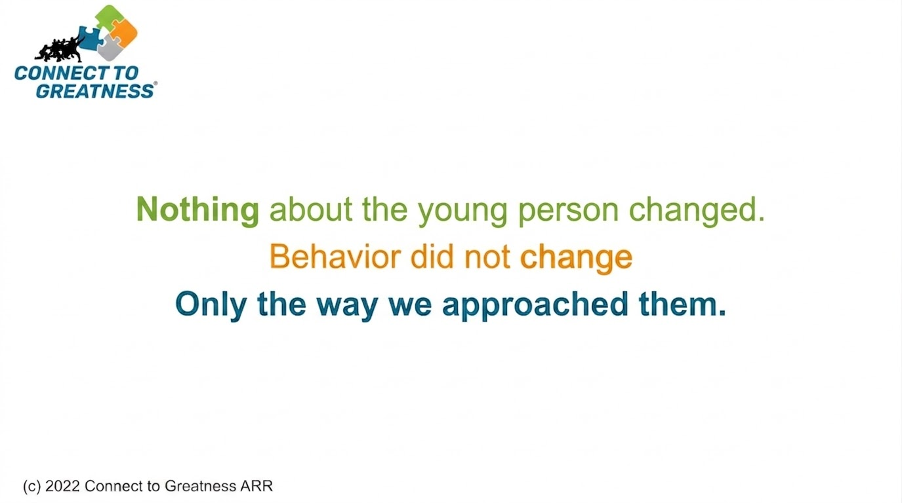


Slide 20
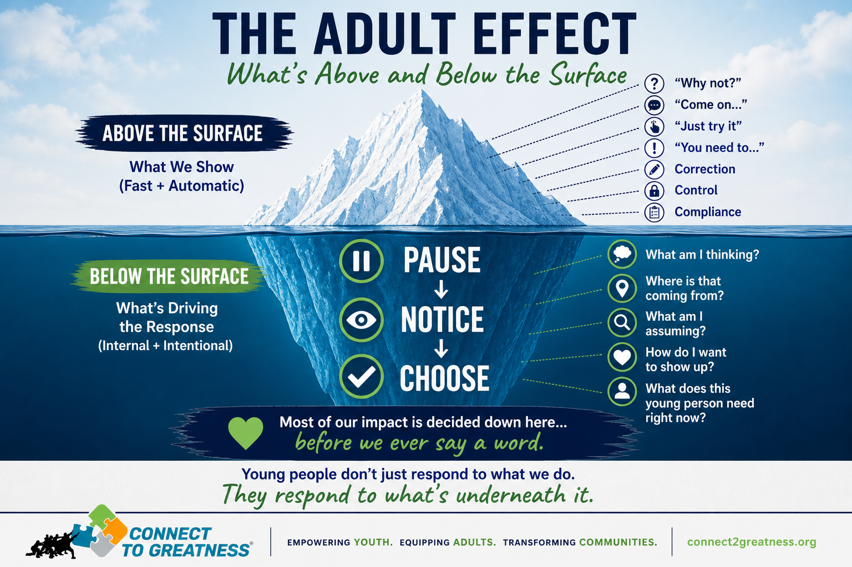

Slide 21


Slide 22
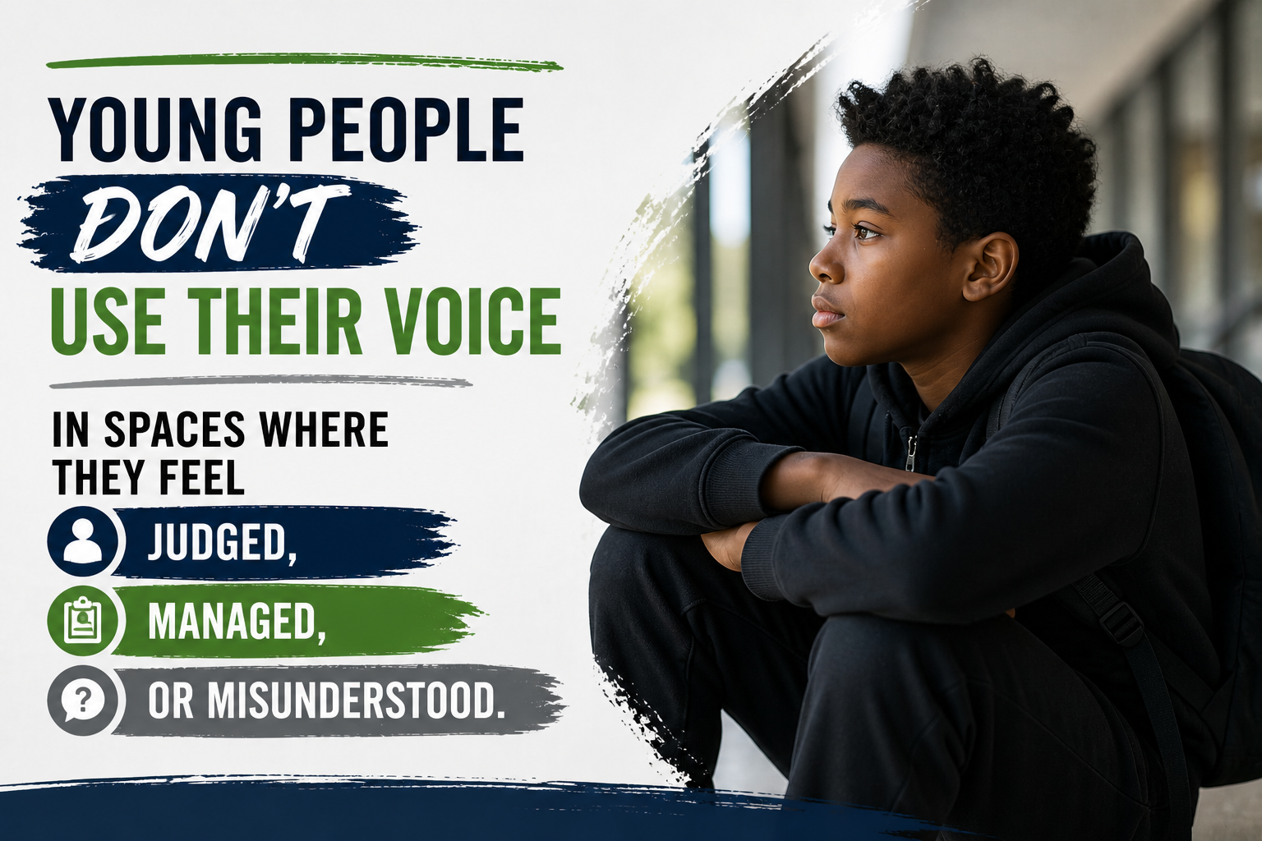
Young people don’t use their voice
in spaces where they feel judged, managed,
or misunderstood.

Slide 23
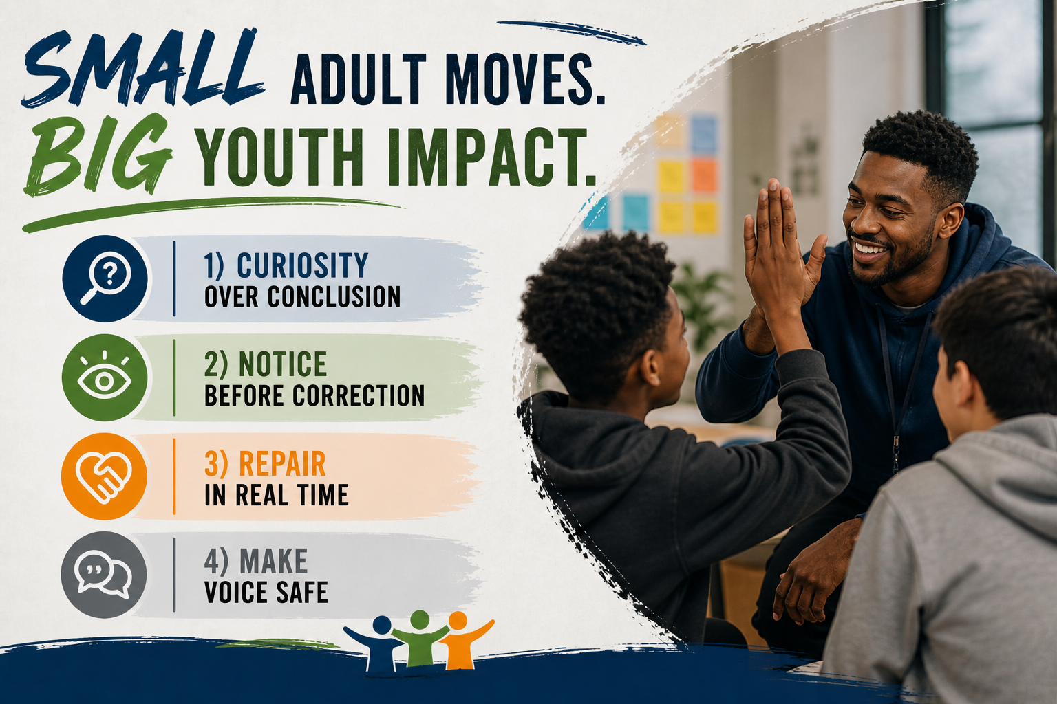
Small Adult Moves. Big Youth Impact.
Curiosity over conclusion
Notice before correction
Repair in real time
Make voice safe

Slide 24


Slide 25

Think of a young person who challenges you.

Slide 26

What do you believe about them…
that you haven’t said out loud?

Slide 27
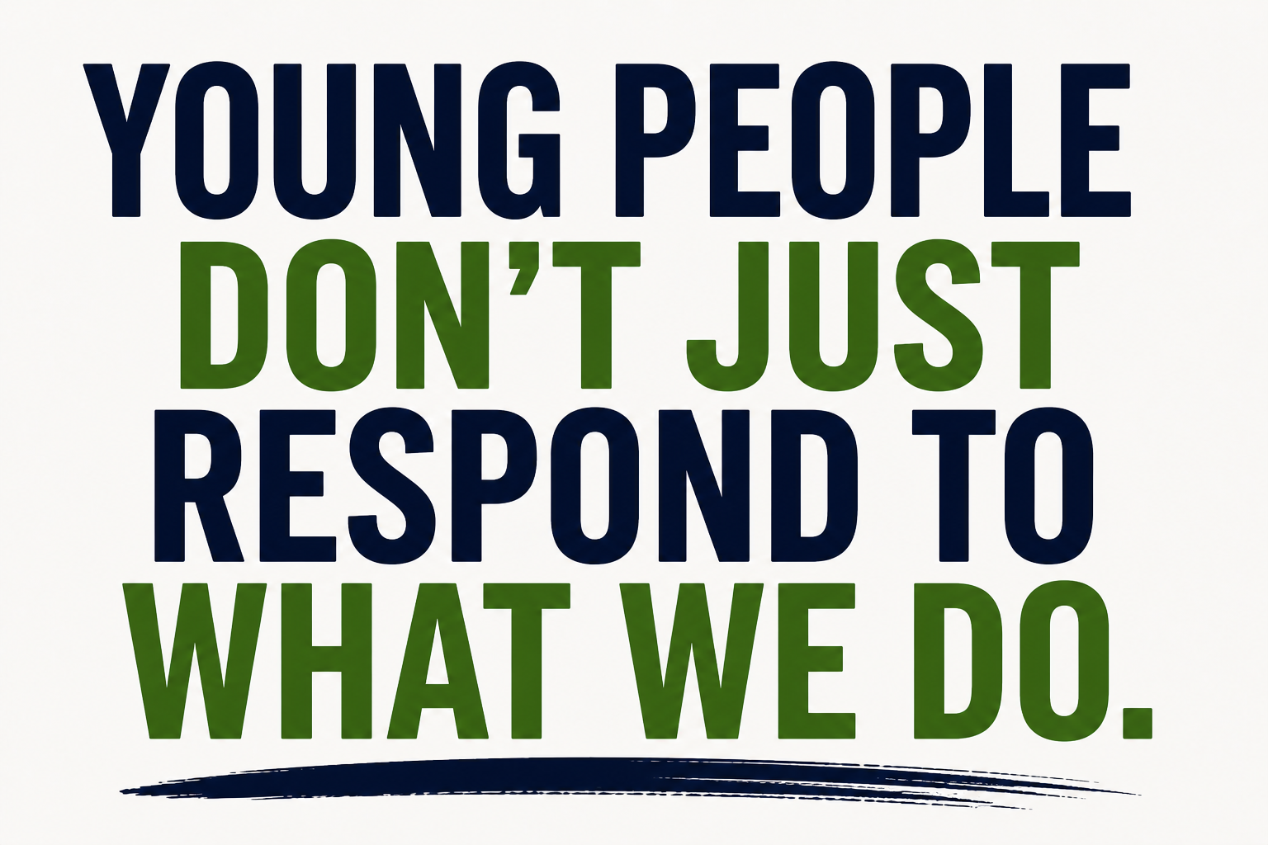

Slide 28


Slide 29

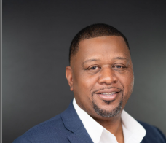


Andre Thaddies, Executive Director
Prime Time Palm Beach County
FUNDERS & PARTNERS
EMAIL
Andrethaddies@connect2greatness.org
SPONSORS
PHONE NUMBER
561.503.8455

Slide 30
